Slide 1


Geometric Stiffness for Real-time Constrained Multi-body Dynamics
Sheldon Andrews^{1,2} Marek Teichmann² Paul G. Kry¹ ¹McGill University ²CM Labs Simulations Inc.

Slide 2
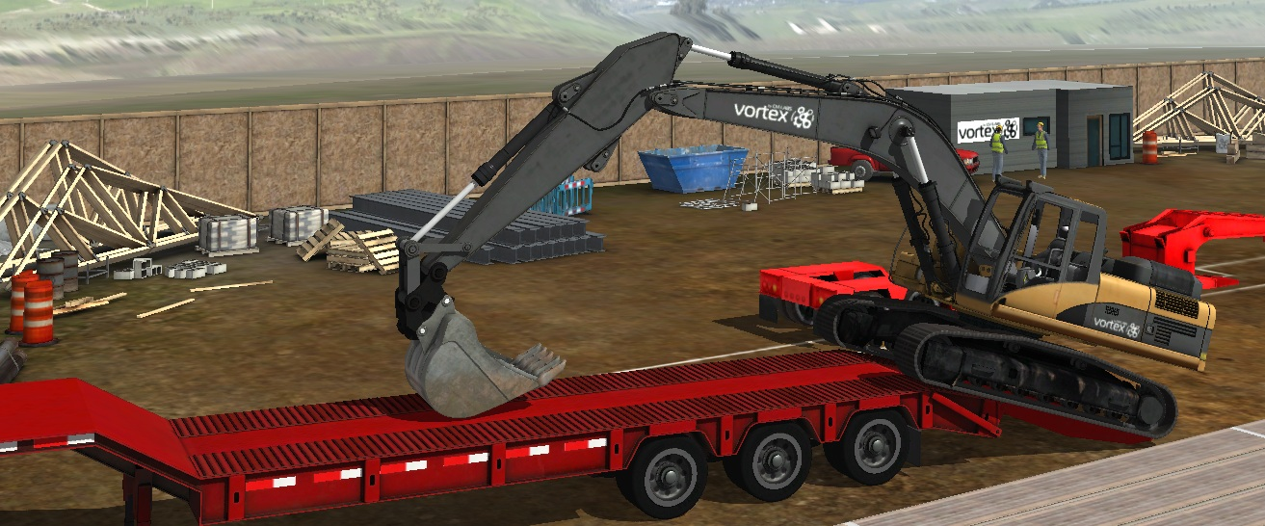
Tonge et al. (2012)
CM Labs Simulations
Ding et al. (2015)
CM Labs Simulations

Slide 3
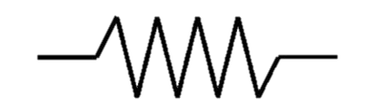
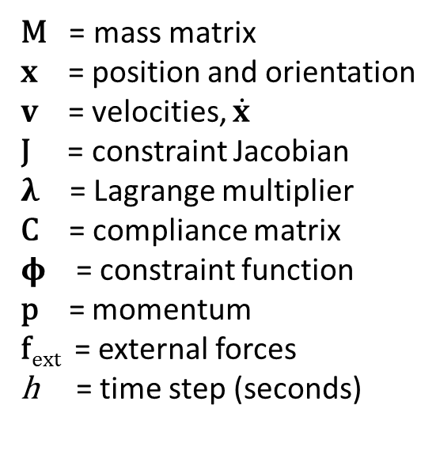
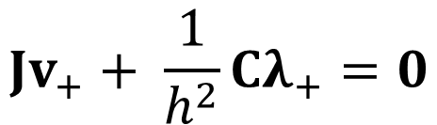






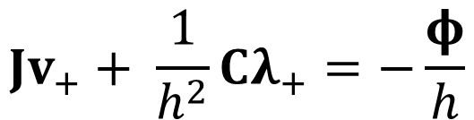
Background: Constrained multi-body physics
M = mass matrix
$x$ = position and orientation $v$ = velocities, $\dot{x}$ J = constraint Jacobian
$λ$ = Lagrange multiplier C = compliance matrix $φ$ = constraint function
p = momentum f_{ext} = external forces h = time step (seconds)
$$λ$$
$$v_{b}$$
$$φ(x)$$
$$v_{a}$$
The velocity level Newton-Euler equations of motion:
$$Mv_{+}−J^{T}λ_{+}=p+hf_{ext}$$
Constraint equations:
$$Jv_{+}+ \frac{1}{h^{2}}Cλ_{+}=0$$
$$Jv_{+}+ \frac{1}{h^{2}}Cλ_{+}=−\frac{φ}{h}$$
Baraff and Witkin (1998)
$$Jv_{+}=0$$
Notes:
Implicit formulation, solve for the velocities at next time step v_+, as well as constraint forces \lambda_+

Slide 4
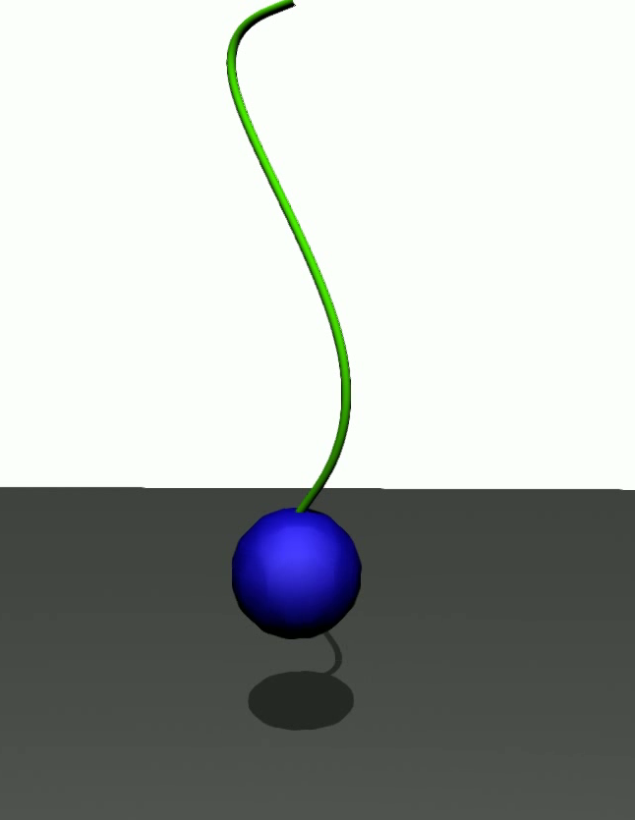


Stability
Problems with large mass ratios, stiff constraints
10 kg
25 kg
50 kg
Notes:
Cable modeled by a chain of rigid bodies and compliant constraints
Mass ratio is 100:1 … 500:1

Slide 5
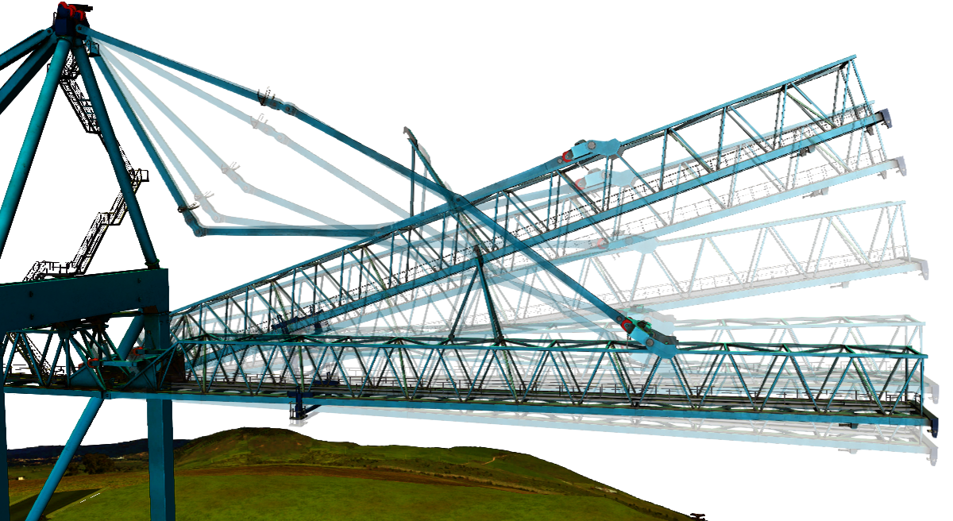
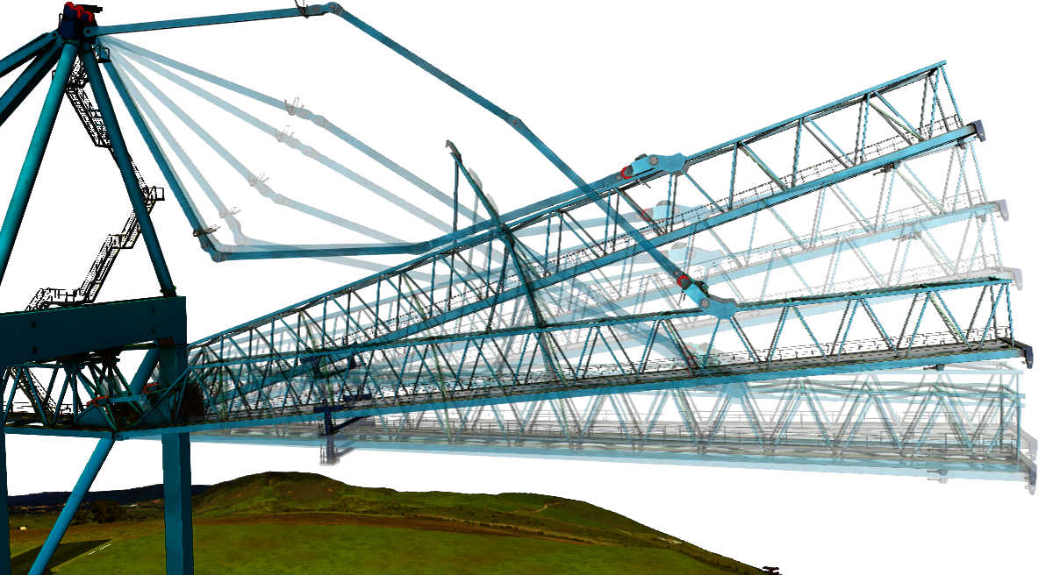
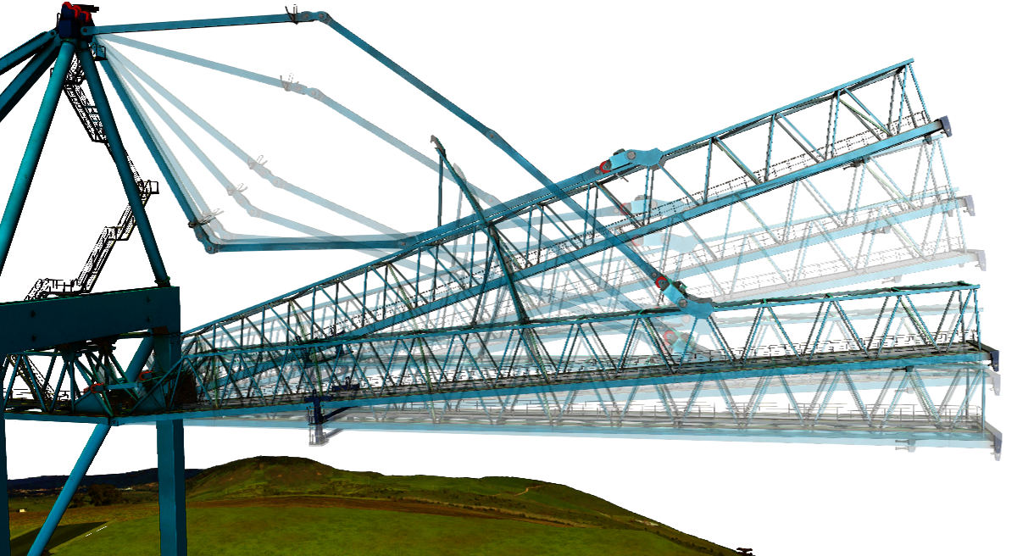
Our approach
Damping technique based on the geometric stiffness
Adaptively dampen based on stability analysis of a symplectic Euler integrator
Linear system has appealing numerical properties
Symmetric, positive definite, diagonal
h=0.1s
h=0.01s
h=0.001s
Notes:
Helps to preserve dynamics and reduce kinetic energy dissipation
The method is automatic and requires very little tuning
Can use Cholesky

Slide 6
Related work
Implicit integration
Constraint drift
Integration scheme
Baraff and Witkin (1998)
Cline and Pai (2003)
Müller et al. (2005)
Notes:
Cline and Pai: introduced the use of Baumgarte and post-step stabilization to prevent positional constraint drift in velocity-based formulations… a different kind of “stability”
Baraff and Witkin: propose the use of implicit integrator to permit large steps in cloth simulation. The single-step implicit integration has become very popular in the graphics community.
Muller: uses a modified explicit integration scheme for elastic body simulations. We perform a similar analysis of the integrator.

Slide 7
Related work
Adaptive simulation
Higher-order models
Geometric stiffness
Servin et al. (2011)
Kaufman et al. (2014)
Tournier et al. (2015)
Notes:
Servin: Adaptively changes cable segment lengths based on vibration analysis. Cables are one of the most challenging cases: long kinematic chains, tiny bodies with small masses attached to large loads
Tournier: Closest to our work, which we build on. They use the geometric stiffness
Kaufman: used higher order models to stabilize hair strands

Slide 8
Stable Constrained Dynamics
Tournier et al. (2015)

Slide 9




What is the geometric stiffness?
Accounts for geometric non-linearities in the constraints
a
$$J_{b}^{T}λ$$
$$\tilde{K}={\frac{∂J}{∂x}}^{T}λ$$
$$dx$$
b
$${d(J}_{b}^{T}λ)$$
Straightforward to compute in its explicit form (Tournier et al., 2015)
Augmented equations of motion:
Improves stability! … but there are problems
$$\left(M−h^{2}\tilde{K}\right)v_{+}−J^{T}λ_{+}=p+hf_{ext}$$
Notes:
Geometric stiffness encodes directions transverse to the constraint Jacobian, i.e. how the constraint forces can change relative to body configurations
Transverse displacements change force direction, not the intensity
Seminal work by Maxime Tournier and the INRIA group
“missing term” in most constrained dynamics formulations Their contribution: explicitly compute the geometric stiffness
Non-constitutive property
Effectively an inertial damping term, has nice stabilizing properties
link to Nocedal and Wright SQP

Slide 10
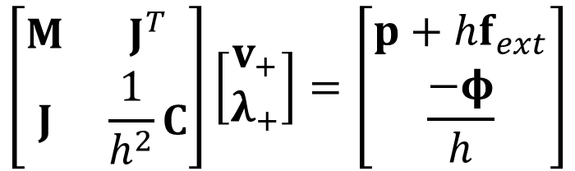
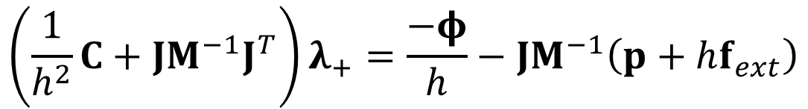
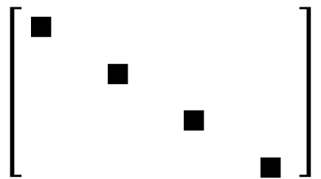
Reduced system of equations
$$\left[\begin{matrix}∎ & & & \\ & ∎ & & \\ & & ∎ & \\ & & & ∎\end{matrix} \right]$$
$$\left[\begin{matrix}M & J^{T} \\ J & \frac{1}{h^{2}}C\end{matrix}\right]\left[\begin{matrix}v_{+} \\ λ_{+}\end{matrix}\right]=\left[\begin{matrix}p+hf_{ext} \\ \frac{−φ}{h}\end{matrix}\right]$$
Schur complement
$$\left(\frac{1}{h^{2}}C+JM^{−1}J^{T}\right)λ_{+}=\frac{−φ}{h}−JM^{−1}\left(p+hf_{ext}\right)$$
Notes:
Mass matrix has block diagonal form
Note the mass inverse is easy to compute

Slide 11
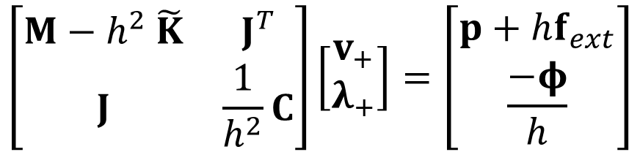

Problem: Numerical issues
Augmented with geometric stiffness:
$$\left[\begin{matrix}∎ & ∗ & & ∗ \\ ∗ & ∎ & & \\ & & ∎∗ & \\ ∗ & & ∗ & ∎\end{matrix} \right]$$
$$\left[\begin{matrix}M−h^{2} \tilde{K} & J^{T} \\ J & \frac{1}{h^{2}}C\end{matrix}\right]\left[\begin{matrix}v_{+} \\ λ_{+}\end{matrix}\right]=\left[\begin{matrix}p+hf_{ext} \\ \frac{−φ}{h}\end{matrix}\right]$$
$$\left(\frac{1}{h^{2}}C+J{\left(M−h^{2}\tilde{K}\right)}^{−1}J^{T}\right)λ_{+}=\frac{−φ}{h}−J{\left(M−h^{2}\tilde{K}\right)}^{−1}\left(p+hf_{ext}\right)$$
Non-symmetric
Not positive definite
Difficult to invert
Notes:
Lead matrix no longer symmetric
Off-diagonal entries can become large… very large!
Block diagonal form of M was previously easy to invert.

Slide 12



Problem: Numerical issues
Mass matrix is block diagonal: Augmented with geometric stiffness:
$$\left[\begin{matrix}∎ & & & \\ & ∎ & & \\ & & ∎ & \\ & & & ∎\end{matrix} \right]$$
$$Mv_{+}−J^{T}λ_{+}=p+hf_{ext}$$
$$\left[\begin{matrix}∎ & ∗ & & ∗ \\ ∗ & ∎ & & \\ & & ∎ & \\ ∗ & & ∗ & ∎\end{matrix} \right]$$
$$(M+h^{2}\tilde{K})v_{+}−J^{T}λ_{+}=p+hf_{ext}$$
Notes:
Lead matrix no longer symmetric
Off-diagonal entries become large… very large!
Block diagonal form of M was previously easy to invert.

Slide 13
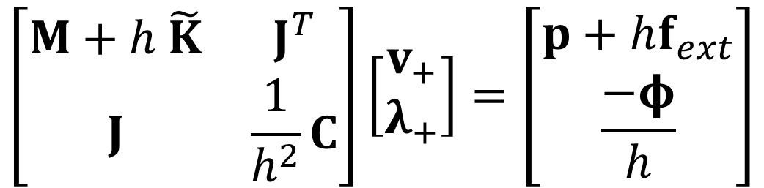
Problem: Numerical issues
Reduced constrained equations of motion
$$\left[\begin{matrix}M+h \tilde{K} & J^{T} \\ J & \frac{1}{h^{2}}C\end{matrix}\right]\left[\begin{matrix}v_{+} \\ λ_{+}\end{matrix}\right]=\left[\begin{matrix}p+hf_{ext} \\ \frac{−φ}{h}\end{matrix}\right]$$
$$\frac{1}{h^{2}}C+J{\left(M+h \tilde{K}\right)}^{−1}J^{T}λ_{+}=\frac{−φ}{h}−J{\left(M+h \tilde{K}\right)}^{−1}\left(p+hf_{ext}\right)$$
What’s the big deal?
Non-symmetric
Non-positive definite
Difficult to invert
Schur complement
Notes:
Schur complement: reformulate as a reduced set of equations
Very common in constrained multibody dynamics… only need to solve for lambdas.

Slide 14
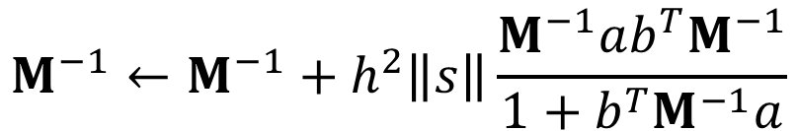
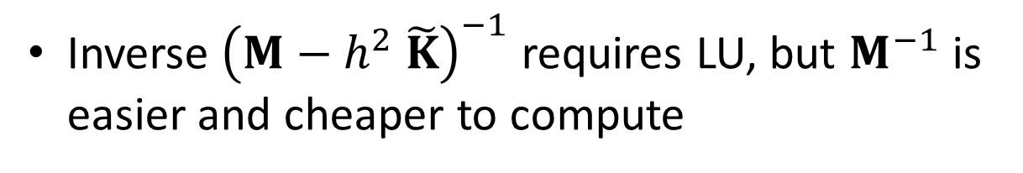
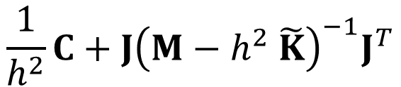
Solution 1: Exploiting sparsity
Geometric stiffness matrix for a ball-and-socket joint.
Geometric stiffness matrix, $\tilde{K}$, tends to be sparse
$$\frac{1}{h^{2}}C+J{\left(M−h^{2} \tilde{K}\right)}^{−1}J^{T}$$
Inverse ${\left(M−h^{2} \tilde{K}\right)}^{−1}$ requires LU, but $M^{−1}$ is easier and cheaper to compute
$$M^{−1}←M^{−1}+h^{2}\left\|s\right\|\frac{M^{−1}ab^{T}M^{−1}}{1+b^{T}M^{−1}a}$$
Sherman-Morrison low rank update

Slide 15
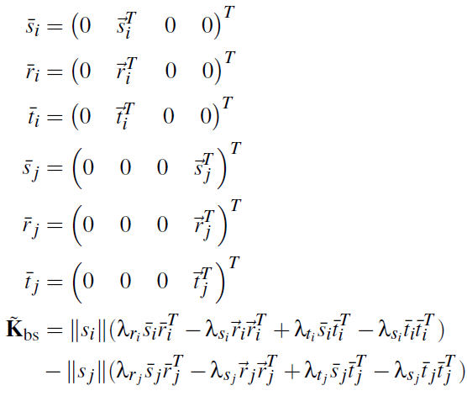

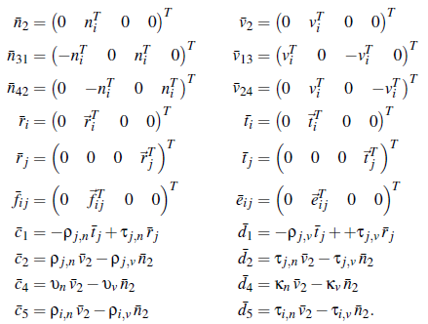
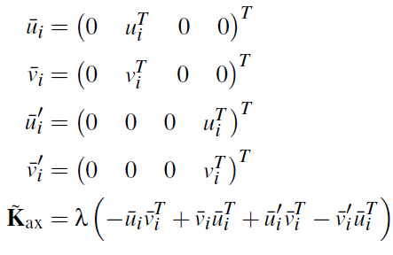
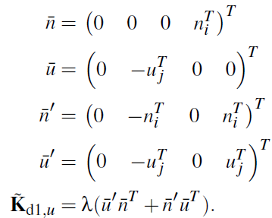
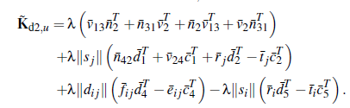
Ball-and-socket
Dot-2
See Appendix B of our paper for more details
Axial
Dot-1
Notes:
Low-rank decomposition of all constraints in the paper.
Can be done by inspecting constraint eqs

Slide 16
Sherman-Morrison vs. LU inverse

Slide 17
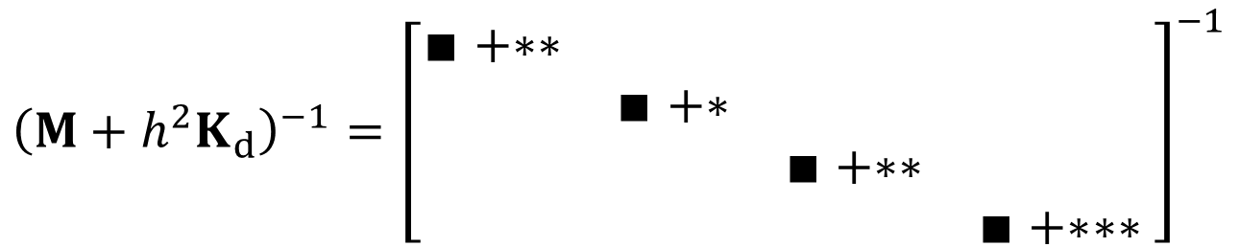
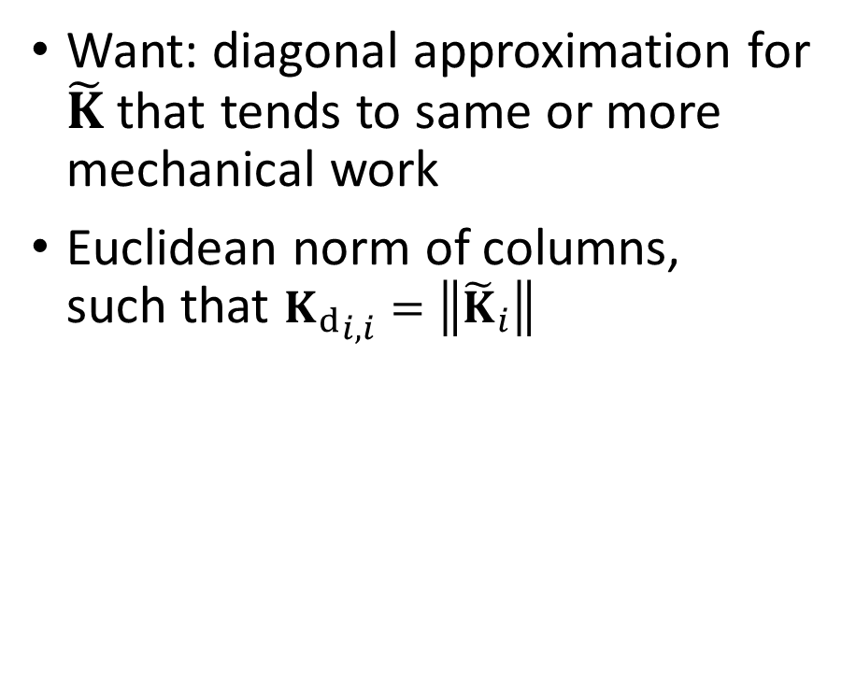
Solution 2: Diagonalization
Want: diagonal approximation for $\tilde{K}$ that tends to same or more mechanical work
Euclidean norm of columns, such that ${K_{d}}_{i,i}=\left\|{\tilde{K}}_{i}\right\|$
Ball-and-socket
Flexible cable joint
$${\left({M+h^{2}K}_{d}\right)}^{−1}={\left[\begin{matrix}∎+∗∗ & & & \\ & ∎+∗ & & \\ & & ∎+∗∗ & \\ & & & ∎+∗∗∗\end{matrix} \right]}^{−1}$$
Notes:
For equal displacements, more mechanical work = stiffer system
i.e. if we underestimate the stiffness, there’s risk of *not* stabilizing!

Slide 18
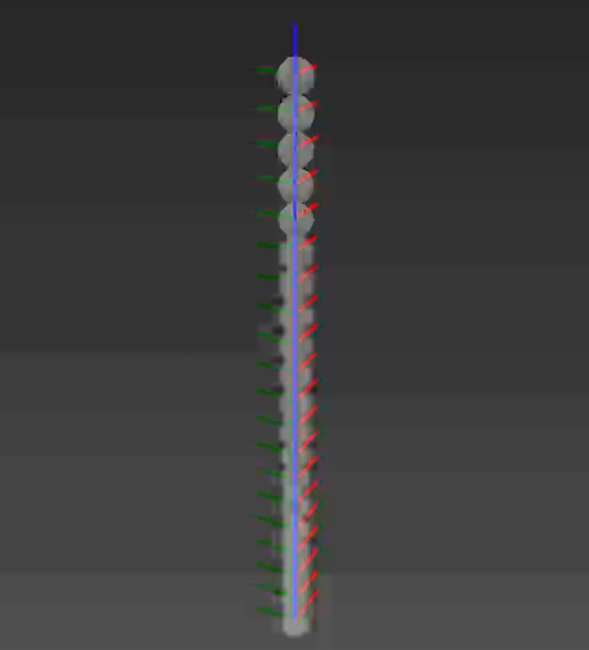
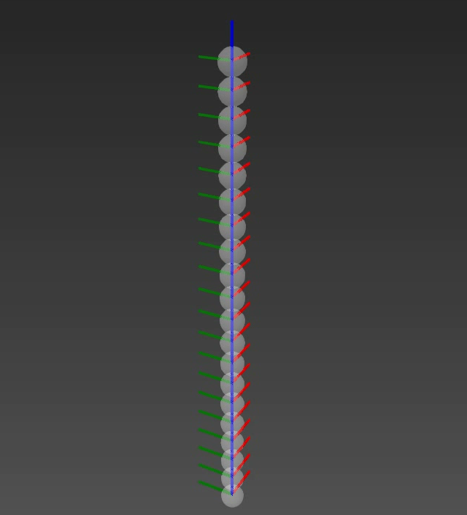
Problem: Dampening
Tends to dissipate kinetic energy very quickly
original
with geometric stiffness
Insight: Geometric stiffness not always required.
Can we estimate when it is?
Notes:
Mention work by colleagues on energy tracking (Hewlett et al 2017)

Slide 19
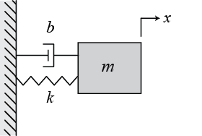
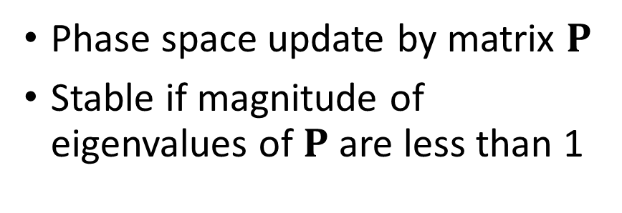
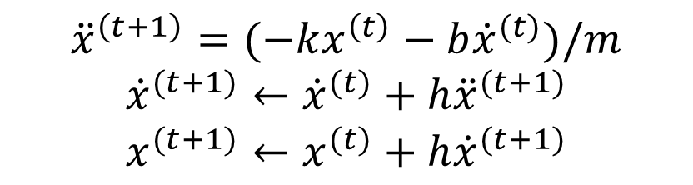
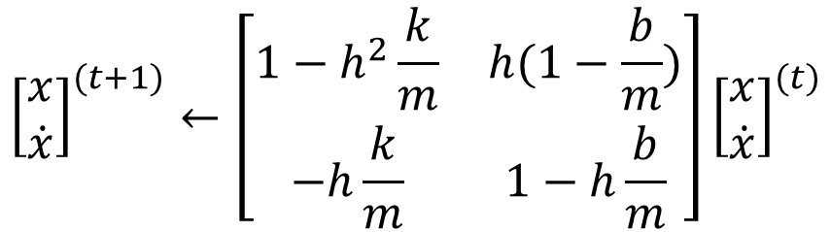
Stability analysis of harmonic oscillator
Phase space update by matrix $P$
Stable if magnitude of eigenvalues of $P$ are less than 1
A simple mass-spring-damper simulated using semi-implicit integration scheme
$${\left[\begin{matrix}x \\ \dot{x}\end{matrix}\right]}^{(t+1)}←\left[\begin{matrix}1−h^{2}\frac{k}{m} & h(1−\frac{b}{m}) \\ −h\frac{k}{m} & 1−h\frac{b}{m}\end{matrix}\right]{\left[\begin{matrix}x \\ \dot{x}\end{matrix}\right]}^{(t)}$$
$${\ddot{x}}^{\left(t+1\right)}=(−kx^{\left(t\right)}−b{\dot{x}}^{(t)})/m$$
$${\dot{x}}^{(t+1)}←{\dot{x}}^{(t)}+h{\ddot{x}}^{(t+1)}$$
$$x^{(t+1)}←x^{(t)}+h{\dot{x}}^{(t+1)}$$
P

Slide 20
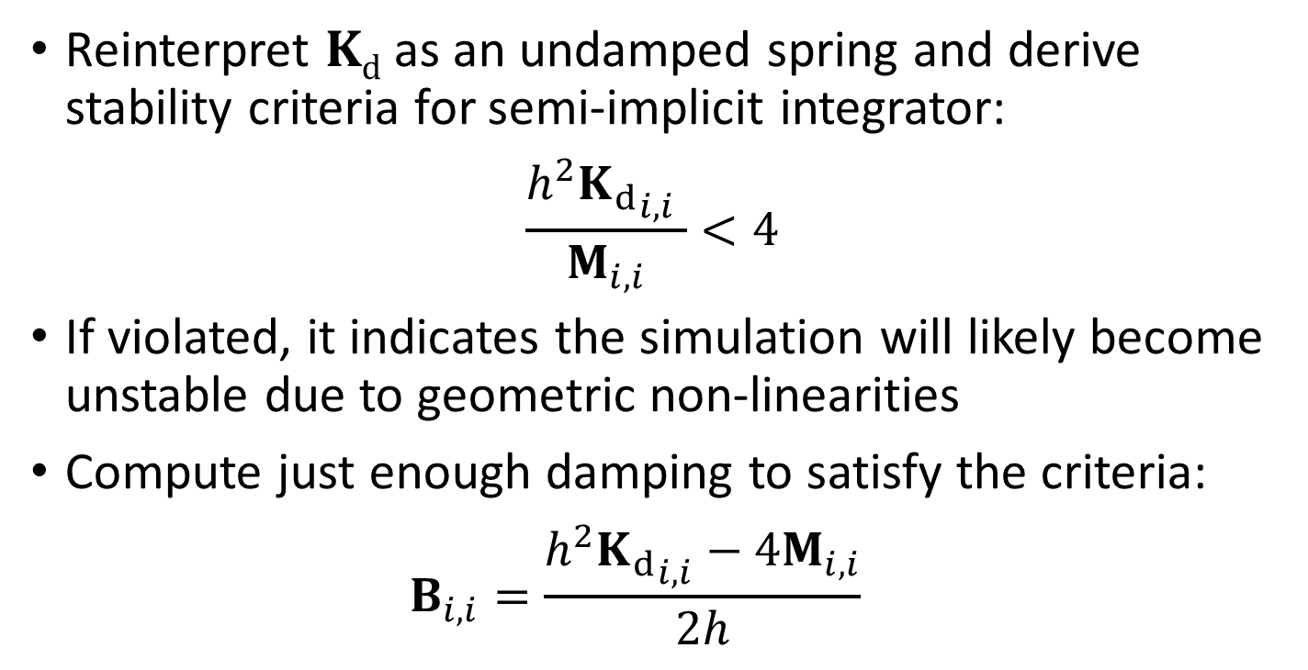



Stability analysis of transverse oscillations
Reinterpret $Kd$ as an undamped spring and derive stability criteria for semi-implicit integrator:
$$\frac{h^{2}{K_{d}}_{i,i} }{M_{i,i}}<4$$
If violated, it indicates the simulation will likely become unstable due to geometric non-linearities
Compute just enough damping to satisfy the criteria: $B_{i,i}=\frac{h^{2}{K_{d}}_{i,i}−4M_{i,i}}{2h}$
$$B_{i,i}$$
$$M_{i,i}$$
$$K_{d_{i,i}}$$
Notes:
We look to our old friend the harmonic oscillator…
\tilde{K} does no represent a constitutive stiffness, but we here we interpret it as one
See details in the paper for how we derive this criteria
Diagonal approximation allows us to apply this simple analysis

Slide 21

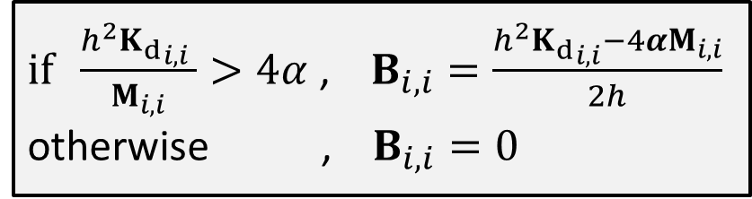
Adaptive inertial damping
Compute diagonal damping matrix $B$ :
The new equations of motion:
$if \frac{h^{2}{K_{d}}_{i,i} }{M_{i,i}}>4α$ , $B_{i,i}=\frac{h^{2}{K_{d}}_{i,i}−4{αM}_{i,i}}{2h}$ otherwise , $B_{i,i}=0$
$$(M+hB)v_{+}−J^{T}λ_{+}=p+hf_{ext}$$
System matrix is now…
Symmetric, positive-definite
Easily inverted
Notes:
“B” replaces the original geometric stiffness.

Slide 22


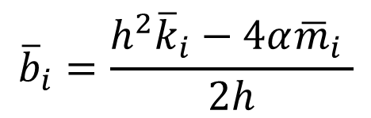


Mapping to constraint space
For each constraint row:
… and adaptively compute a constraint damping factor:
$${\overline{m}}_{i}={\left(J_{i}M^{−1}J_{i}^{T}\right)}^{−1}$$
$${\overline{k}}_{i}={\left(J_{i}K_{d}^{−1}J_{i}^{T}\right)}^{−1}$$
Constraint forces generated by spring-damper:
$${\overline{b}}_{i}=\frac{h^{2}{\overline{k}}_{i}−4α{\overline{m}}_{i} }{2h}$$
$$λ_{+}=−C^{−1}φ_{+}−\overline{B} {\dot{φ}}_{+}$$
Notes:
Details are in the paper

Slide 23
Results

Slide 24
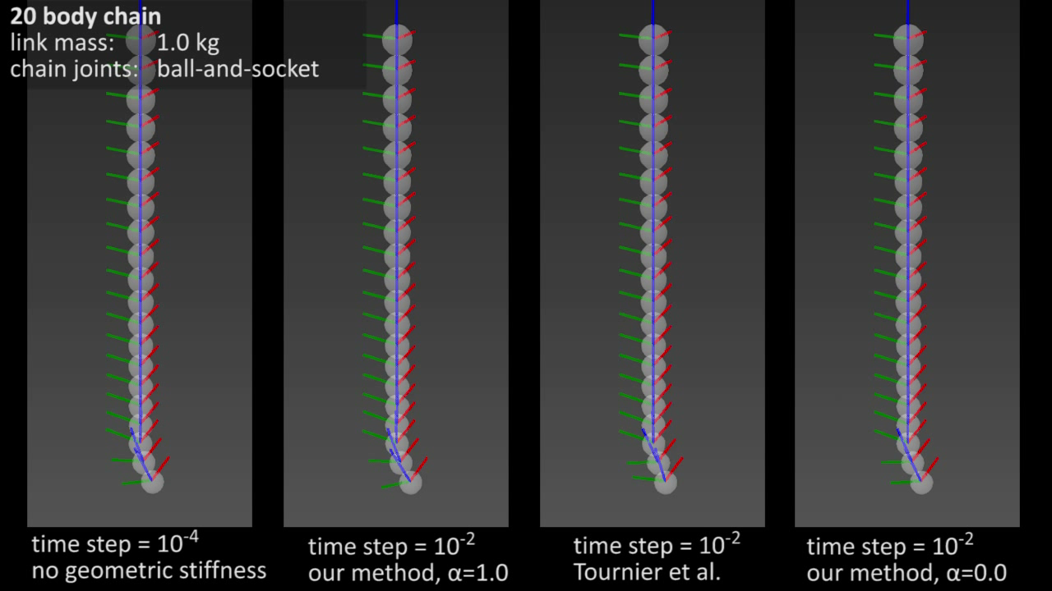

Slide 25
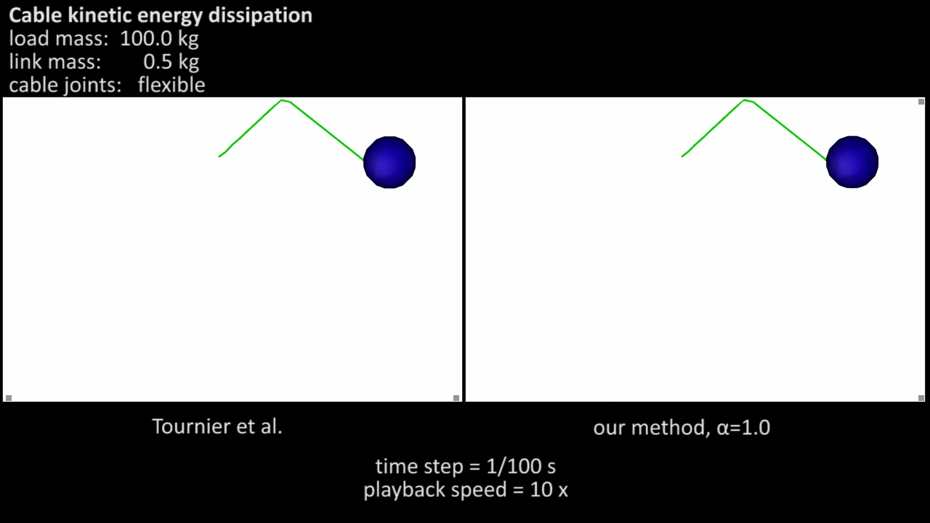

Slide 27
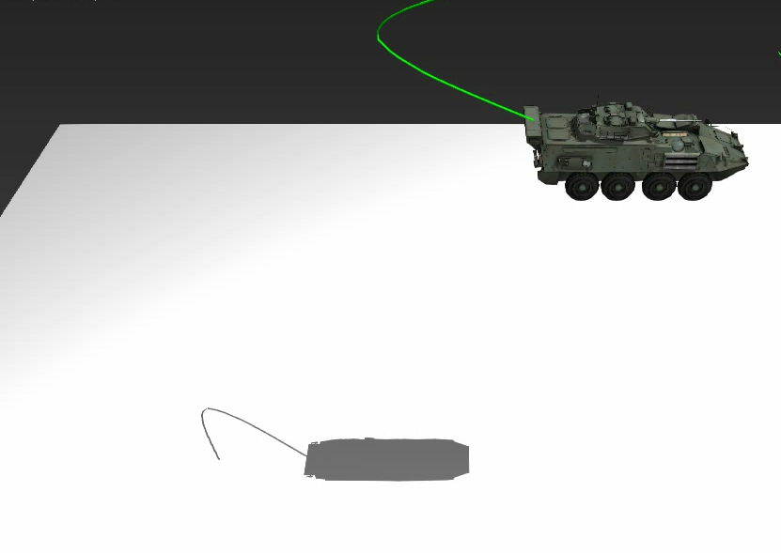




Ground truth, h=1e-5
Ours ($α=1.0,$h=1e-2)
Ours ($α=0.0,$h=1e-2)

Slide 29
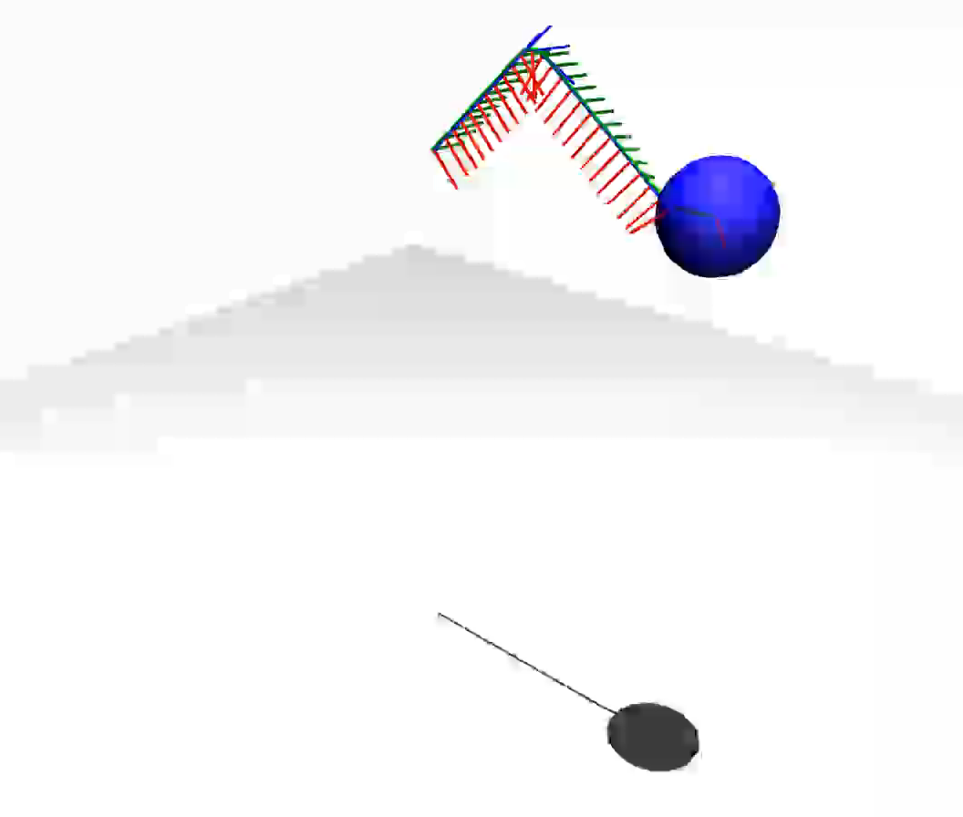

Inertial
Constraint space

Slide 30
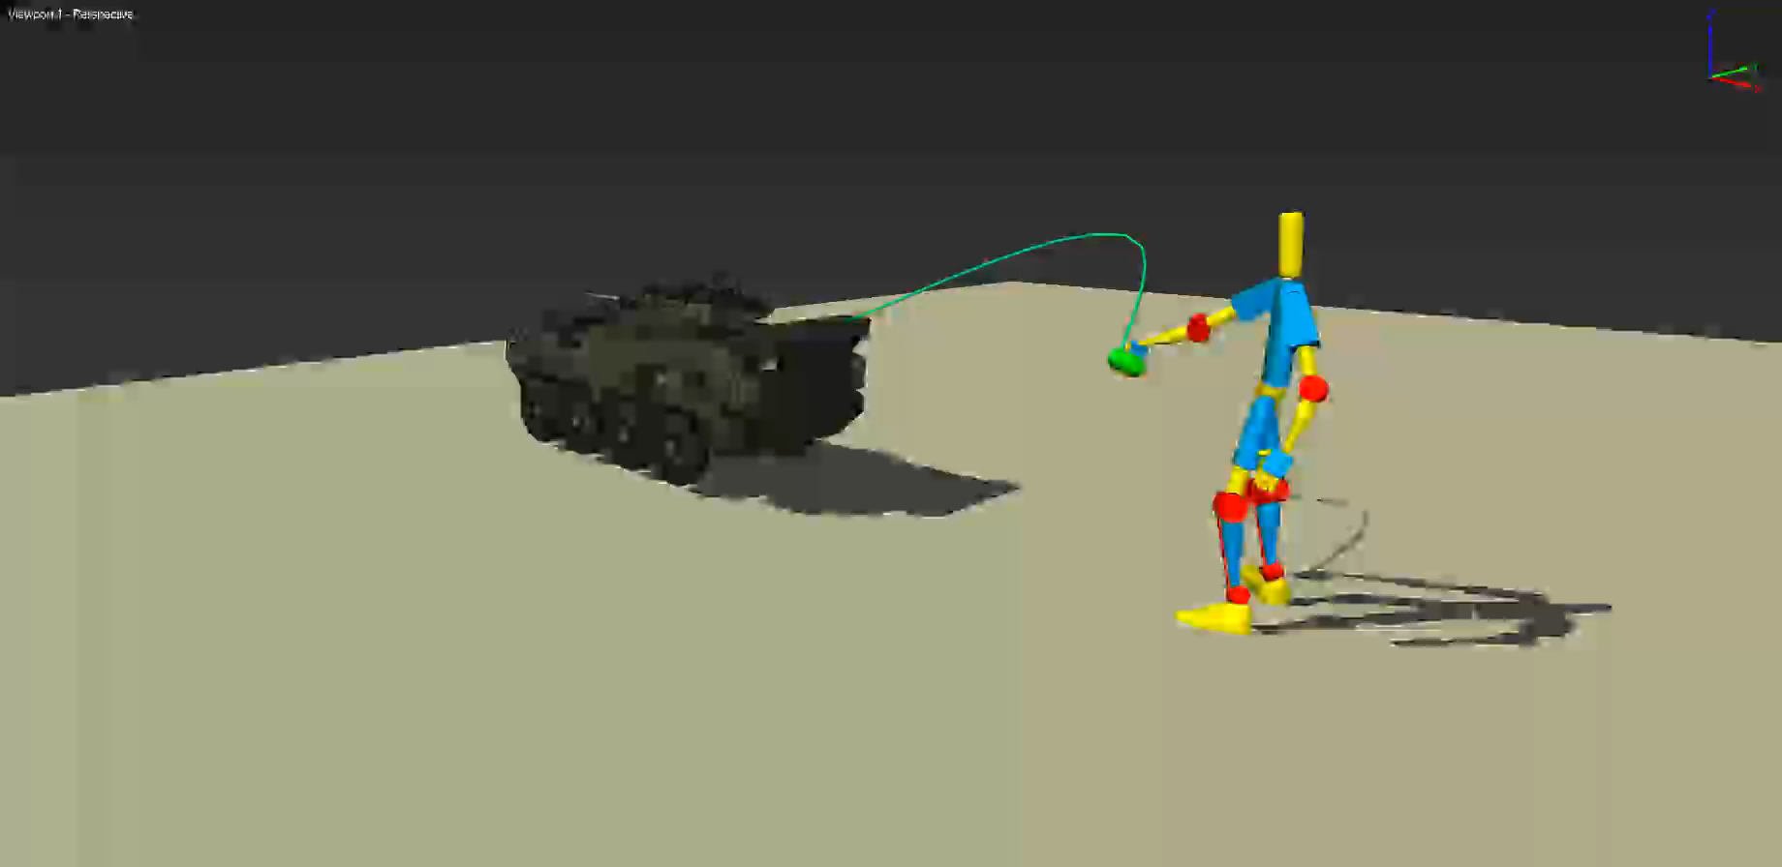
Notes:
Character animation example
PD servos, fingertips are modeled by small bodies, attached to end of cable by ball-and-socket joints
Motorized prismastic joint to move the vehicle

Slide 31
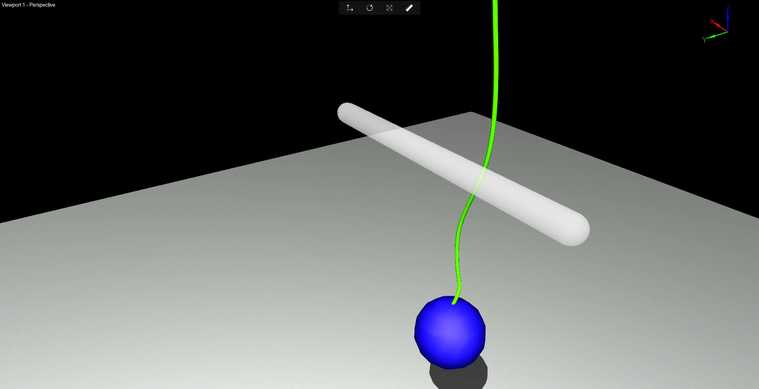

Slide 32
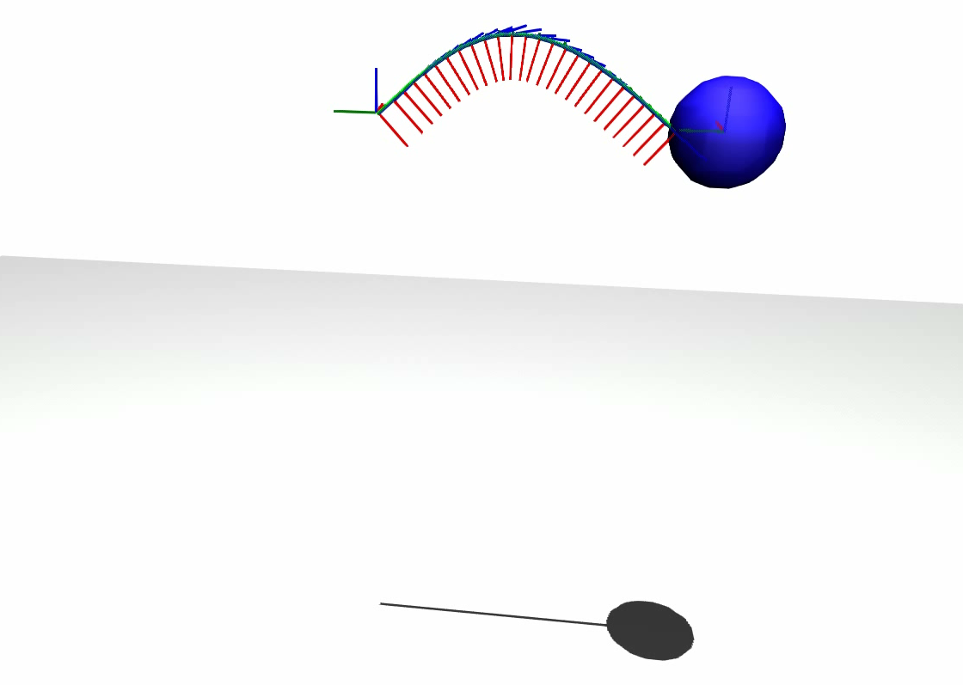

Limitation… and a fix
Geometric non-linearities due mainly to angular DOFs
Artefacts when damping linear DOFs, ignore them
Linear+angular
Angular

Slide 33
Conclusion
Geometric stiffness reinterpreted as a spring and used in stability analysis, adaptive damping scheme
Projection to constraint space useful, but only possible with 6D joints
Non-linearity articulated simulation mainly affected by angular DOFs
Geometric stiffness tends to be sparse, low rank updates to inverse mass matrix

Slide 34
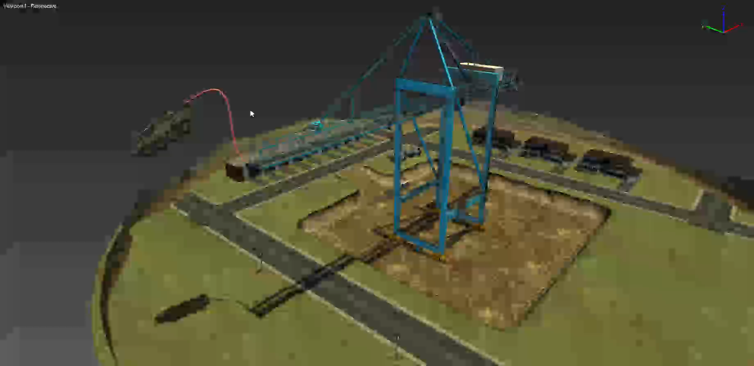
Thank you! Questions?

Slide 35
Extra slides

Slide 36

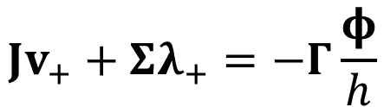
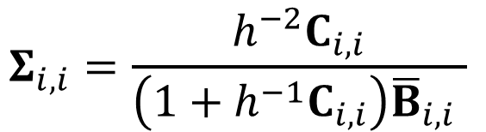
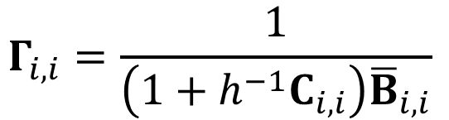
Constraint space damping
Constraint forces generated by spring-damper:
Reorganize constraint equations: where…
$$λ_{+}=−C^{−1}φ_{+}−\overline{B} {\dot{φ}}_{+}$$
$$Jv_{+}+Σλ_{+}=−Γ\frac{φ}{h}$$
$$Γ_{i,i}=\frac{1}{\left(1+h^{−1}C_{i,i}\right){\overline{B}}_{i,i}}$$
$$Σ_{i,i}=\frac{h^{−2}C_{i,i}}{\left(1+h^{−1}C_{i,i}\right){\overline{B}}_{i,i} }$$

Slide 37
Cable stabilization
Dampen cable oscillations that occur during high tension
Adaptive: Give engineers a slope and x-intercept to tune (linear)
damping
tension
Notes:
Very Little damping <- nominal tension
Lots of damping <- high tension
NO COMPUTATIONAL OVERHEAD

