Slide 1
COMP/MATH 553: Algorithmic Game Theory
Lecture 25
Fall 2016
Yang Cai

Slide 2

WINE 2016
Dec 11-14 @ InterContinental Hotel. http://cs.mcgill.ca/~wine2016/index.html. Feel free to come. Let me know if you want to be a volunteer.

Slide 3
Sperner’s Lemma (recap)
no yellow
no blue
no red
Lemma: Color the boundary using three colors in a legal way. No matter how the internal nodes are colored, there exists a tri-chromatic triangle. In fact an odd number of those.

Slide 4
Proof of Sperner’s Lemma
Claim: The walk cannot exit the square, nor can it loop around itself in a rho-shape. Hence, it must stop somewhere inside. This can only happen at tri-chromatic triangle…
For convenience we introduce an outer boundary, that does not create new tri-chromatic triangles.
Next we define a directed walk starting from the bottom-left triangle.
!
Starting from other triangles we do the same going forward or backward.
Lemma: Color the boundary using three colors in a legal way. No matter how the internal nodes are colored, there exists a tri-chromatic triangle. In fact an odd number of those.

Slide 5
Proof of Brouwer’s Fixed Point Theorem
We show that Sperner’s Lemma implies Brouwer’s Fixed Point Theorem. We start with the 2-dimensional Brouwer problem on the square.

Slide 6
2D-Brouwer on the Square
Suppose ƒ: [0,1]² →[0,1]², continuous
must be uniformly continuous (by the Heine-Cantor theorem)
1
0
0
1

Slide 7
2D-Brouwer on the Square
Suppose ƒ: [0,1]² →[0,1]², continuous
must be uniformly continuous (by the Heine-Cantor theorem)
1
choose some and
triangulate so that the diameter of cells is
0
0
1

Slide 8
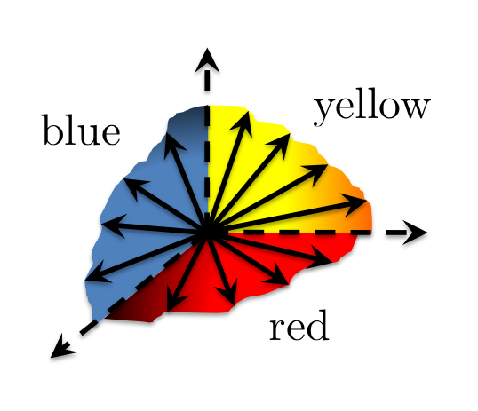
2D-Brouwer on the Square
Suppose ƒ: [0,1]² →[0,1]², continuous
must be uniformly continuous (by the Heine-Cantor theorem)
color the nodes of the triangulation according to the direction of
1
choose some and
triangulate so that the diameter of cells is
0
0
1

Slide 9
2D-Brouwer on the Square
Suppose ƒ: [0,1]² →[0,1]², continuous
must be uniformly continuous (by the Heine-Cantor theorem)
color the nodes of the triangulation according to the direction of
1
choose some and
triangulate so that the diameter of cells is
tie-break at the boundary angles, so that the resulting coloring respects the boundary conditions required by Sperner’s lemma
find a trichromatic triangle, guaranteed by Sperner
0
0
1

Slide 10
2D-Brouwer on the Square
Suppose ƒ: [0,1]² →[0,1]², continuous
must be uniformly continuous (by the Heine-Cantor theorem)
1
Claim: If z^{Y} is the yellow corner of a trichromatic triangle, then
0
0
1

Slide 11
Proof of Claim
Claim: If z^{Y} is the yellow corner of a trichromatic triangle, then
Proof: Let z^{Y}, z^{R} , z^{B} be the yellow/red/blue corners of a trichromatic triangle.
By the definition of the coloring, observe that the product of
Hence:
1
Similarly, we can show:
0
0
1

Slide 12
2D-Brouwer on the Square
Suppose ƒ: [0,1]² →[0,1]², continuous
must be uniformly continuous (by the Heine-Cantor theorem)
1
Claim: If z^{Y} is the yellow corner of a trichromatic triangle, then
Choosing
0
0
1

Slide 13
2D-Brouwer on the Square
Finishing the proof of Brouwer’s Theorem:
- pick a sequence of epsilons:
- define a sequence of triangulations of diameter:
- pick a trichromatic triangle in each triangulation, and call its yellow corner
- by compactness, this sequence has a converging subsequence
with limit point
Claim:
Proof:
Define the function . Clearly, is continuous since is continuous and so is . It follows from continuity that
But . Hence, . It follows that .
Therefore,

Slide 14
How hard is computing a Nash Equilibrium?

Slide 15
NASH, BROUWER and SPERNER
We informally define three computational problems:
NASH: find a (appx-) Nash equilibrium in a n player game.
BROUWER: find a (appx-) fixed point x for a continuous function f().
SPERNER: find a trichromatic triangle (panchromatic simplex) given a legal coloring.

Slide 16
Function NP (FNP)
A search problem L is defined by a relation R_{L}(x, y) such that
R_{L}(x, y)=1 iff y is a solution to x
A search problem is called total iff for all x there exists y such that R_{L}(x, y) =1.
A search problem L belongs to FNP iff there exists an efficient algorithm A_{L}(x, y) and a polynomial function p_{L}( ⋅ ) such that
(i) if A_{L}(x, z)=1 ➔ R_{L}(x, z)=1
(ii) if ∃ y s.t. R_{L}(x, y)=1 ➔ ∃ z with |z| ≤ p_{L}(|x|) such that A_{L}(x, z)=1
Clearly, SPERNER ∈ FNP.

Slide 17
Reductions between Problems
A search problem L ∈ FNP, associated with A_{L}(x, y) and p_{L} , is polynomial-time reducible to another problem L’ ∈ FNP, associated with A_{L’}(x, y) and p_{L’}, iff there exist efficiently computable functions f, g such that
(i) x is input to L ➔ f(x) is input to L’
(ii)
A_{L’} (f(x), y)=1 ➔ A_{L}(x, g(y))=1
R_{L’} (f(x), y)=0, ∀ y ➔ R_{L}(x, y)=0, ∀ y
A search problem L is FNP-complete iff
e.g. SAT
L ∈ FNP
L’ is poly-time reducible to L, for all L’ ∈ FNP

Slide 18
Our Reductions (intuitively)
NASH
BROUWER
SPERNER
∈ FNP
both Reductions are polynomial-time
Is then SPERNER FNP-complete?
- With our current notion of reduction the answer is no, because SPERNER always has a solution, while a SAT instance may not have a solution;
- To attempt an answer to this question we need to update our notion of reduction. Suppose we try the following: we require that a solution to SPERNER informs us about whether the SAT instance is satisfiable or not, and provides us with a solution to the SAT instance in the ``yes’’ case;
but if such a reduction existed, it could be turned into a non-deterministic algorithm for checking “no” answers to SAT: guess the solution to SPERNER; this will inform you about whether the answer to the SAT instance is “yes” or “no”, leading to
…
- Another approach would be to turn SPERNER into a non-total problem, e.g. by removing the boundary conditions; this way, SPERNER can be easily shown FNP-complete, but all the structure of the original problem is lost in the reduction.

Slide 19
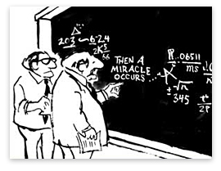
A Complexity Theory of Total Search Problems ?
??

Slide 20
A Complexity Theory of Total Search Problems ?
100-feet overview of our methodology:
1. identify the combinatorial argument of existence, responsible for making the problem total;
2. define a complexity class inspired by the argument of existence;
3. make sure that the complexity of the problem was captured as tightly as possible (via a completeness result).

Slide 21
Recall Proof of Sperner’s Lemma
Space of Triangles
Starting Triangle
...

Slide 22
Combinatorial argument of existence?

Slide 23
The Non-Constructive Step
an easy parity lemma:
  a directed graph with an unbalanced node (a node with indegree ≠ outdegree) must have another.
but, why is this non-constructive?
  given a directed graph and an unbalanced node, isn’t it trivial to find another unbalanced node?
the graph can be exponentially large, but has succinct description…

Slide 24



The PPAD Class [Papadimitriou ’94]
Suppose that an exponentially large graph with vertex set {0,1}^{n} is defined by two circuits:
possible previous
node id
P
node id
node id
N
node id
possible next
END OF THE LINE:
Given P and N: If 0^{n} is an unbalanced node, find another unbalanced node. Otherwise say “yes”.
PPAD =
{ Search problems in FNP reducible to END OF THE LINE}
Notes:
Polynomial Parity Arguments on Directed graphs

Slide 25
Inclusions
(i)
(ii)
PROOF (sketch):
Sufficient to define appropriate circuits P and N as we have in our proof.
Each triangle is associated with a node id.
If there is a red- yellow door such that red is on your left, then cross this door, you will enter the successor triangle.
If there is a red- yellow door such that red is on your right, then cross this door, you will enter the predecessor triangle.

Slide 27
Hardness Results

Slide 28
Inclusions we have already established:
Our next goal:

Slide 29
The Main Result
Theorem [Daskalakis-Goldberg-Papadimitriou ’06, Chen-Deng ’06]: Finding a Nash equilibrium of a 2-player game is a PPAD-complete problem.

Slide 30
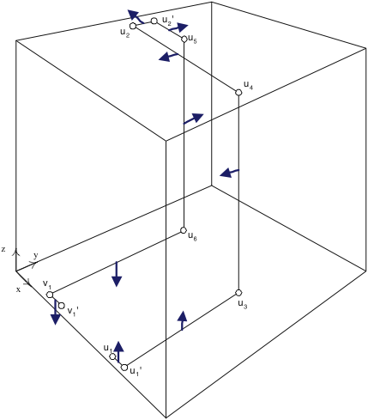
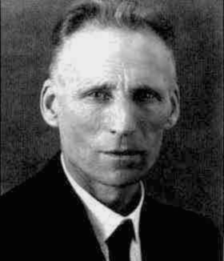
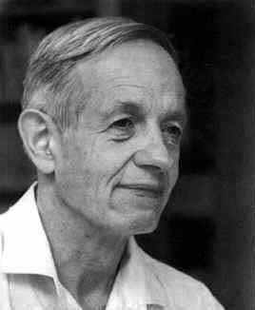
Proof Sketch
DGP = Daskalakis, Goldberg, Papadimitriou
CD = Chen, Deng
[Pap ’94]
[DGP ’05]
0^{n}
Embed PPAD graph in [0,1]³
...
Generic PPAD
[DGP ’05]
4-player
NASH
[DGP ’05]
[DP ’05]
3-player
NASH
[DGP ’05]
[DGP ’05]
[CD’05]
[CD’06]
2-player
NASH
p.w. linear
BROUWER
multi-player
NASH
3D-SPERNER

