Slide 1
COMP 553: Algorithmic Game Theory
Lecture 21
Fall 2014
Yang Cai

Slide 2
How hard is computing a Nash Equilibrium?

Slide 3
NASH, BROUWER and SPERNER
We informally define three computational problems:
NASH: find a (appx-) Nash equilibrium in a n player game.
BROUWER: find a (appx-) fixed point x for a continuous function f().
SPERNER: find a trichromatic triangle (panchromatic simplex) given a legal coloring.

Slide 4
Function NP (FNP)
A search problem L is defined by a relation R_{L}(x, y) such that
R_{L}(x, y)=1 iff y is a solution to x
A search problem is called total iff for all x there exists y such that R_{L}(x, y) =1.
A search problem L belongs to FNP iff there exists an efficient algorithm A_{L}(x, y) and a polynomial function p_{L}( ⋅ ) such that
(i) if A_{L}(x, z)=1 ➔ R_{L}(x, z)=1
(ii) if ∃ y s.t. R_{L}(x, y)=1 ➔ ∃ z with |z| ≤ p_{L}(|x|) such that A_{L}(x, z)=1
Clearly, SPERNER ∈ FNP.

Slide 5
Reductions between Problems
A search problem L ∈ FNP, associated with A_{L}(x, y) and p_{L} , is polynomial-time reducible to another problem L’ ∈ FNP, associated with A_{L’}(x, y) and p_{L’}, iff there exist efficiently computable functions f, g such that
(i) x is input to L ➔ f(x) is input to L’
(ii)
A_{L’} (f(x), y)=1 ➔ A_{L}(x, g(y))=1
R_{L’} (f(x), y)=0, ∀ y ➔ R_{L}(x, y)=0, ∀ y
A search problem L is FNP-complete iff
e.g. SAT
L ∈ FNP
L’ is poly-time reducible to L, for all L’ ∈ FNP

Slide 6
Our Reductions (intuitively)
NASH
BROUWER
SPERNER
∈ FNP
both Reductions are polynomial-time
Is then SPERNER FNP-complete?
- With our current notion of reduction the answer is no, because SPERNER always has a solution, while a SAT instance may not have a solution;
- To attempt an answer to this question we need to update our notion of reduction. Suppose we try the following: we require that a solution to SPERNER informs us about whether the SAT instance is satisfiable or not, and provides us with a solution to the SAT instance in the ``yes’’ case;
but if such a reduction existed, it could be turned into a non-deterministic algorithm for checking “no” answers to SAT: guess the solution to SPERNER; this will inform you about whether the answer to the SAT instance is “yes” or “no”, leading to
…

Slide 7
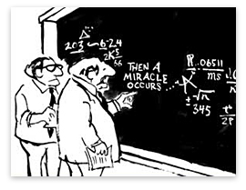
A Complexity Theory of Total Search Problems ?
??

Slide 8
A Complexity Theory of Total Search Problems ?
100-feet overview of our methodology:
1. identify the combinatorial argument of existence, responsible for making the problem total;
2. define a complexity class inspired by the argument of existence;
3. make sure that the complexity of the problem was captured as tightly as possible (via a completeness result).

Slide 9
Recall Proof of Sperner’s Lemma
Space of Triangles
Starting Triangle
...

Slide 10
Combinatorial argument of existence?

Slide 11
The Non-Constructive Step
an easy parity lemma:
  a directed graph with an unbalanced node (a node with indegree ≠ outdegree) must have another.
but, why is this non-constructive?
  given a directed graph and an unbalanced node, isn’t it trivial to find another unbalanced node?
the graph can be exponentially large, but has succinct description…

Slide 12



The PPAD Class [Papadimitriou ’94]
Suppose that an exponentially large graph with vertex set {0,1}^{n} is defined by two circuits:
possible previous
node id
P
node id
node id
N
node id
possible next
END OF THE LINE:
Given P and N: If 0^{n} is an unbalanced node, find another unbalanced node. Otherwise say “yes”.
PPAD =
{ Search problems in FNP reducible to END OF THE LINE}

Slide 13
Inclusions
(i)
(ii)
PROOF (sketch):
Sufficient to define appropriate circuits P and N as we have in our proof.
Each triangle is associated with a node id.
If there is a red- yellow door such that red is on your left, then cross this door, you will enter the successor triangle.
If there is a red- yellow door such that red is on your right, then cross this door, you will enter the predecessor triangle.

Slide 15
Other arguments of existence, and resulting complexity classes
“If a graph has a node of odd degree, then it must have another.”
PPA
“Every directed acyclic graph must have a sink.”
PLS
“If a function maps n elements to n-1 elements, then there is a collision.”
PPP
Formally?

Slide 16
The Class PPA [Papadimitriou ’94]
“If a graph has a node of odd degree, then it must have another.”
Suppose that an exponentially large graph with vertex set {0,1}^{n} is defined by one circuit:
possible neighbors
node id
C
{ node id₁ , node id₂}
ODD DEGREE NODE:
Given C: If 0^{n} has odd degree, find another node with odd degree. Otherwise say “yes”.
PPA =
{ Search problems in FNP reducible to ODD DEGREE NODE}

Slide 17
The Undirected Graph
{0,1}^{n}
0^{n}
...
= solution

Slide 18
The Class PLS [JPY ’89]
“Every DAG has a sink.”
Suppose that a DAG with vertex set {0,1}^{n} is defined by two circuits:
node id
C
{node id₁, …, node id_{k}}
node id
F
FIND SINK:
Given C, F: Find x s.t. F(x) ≥ F(y), for all y ∈ C(x).
PLS =
{ Search problems in FNP reducible to FIND SINK}

Slide 19
The DAG
{0,1}^{n}
= solution

Slide 20
The Class PPP [Papadimitriou ’94]
“If a function maps n elements to n-1 elements, then there is a collision.”
Suppose that an exponentially large graph with vertex set {0,1}^{n} is defined by one circuit:
node id
C
node id
COLLISION:
Given C: Find x s.t. C( x )= 0^{n}; or find x ≠ y s.t. C(x)=C(y).
PPP =
{ Search problems in FNP reducible to COLLISION }

Slide 21
Notes:
Exercise: Show that PPAD is a subset of PPP.

Slide 22
Hardness Results

Slide 23
Inclusions we have already established:
Our next goal:

Slide 24
The Main Result
Theorem[DGP, CD]: Finding a Nash equilibrium of a 2-player game is a PPAD-complete problem.
DGP = Daskalakis, Goldberg, Papadimitriou
CD = Chen, Deng

Slide 25
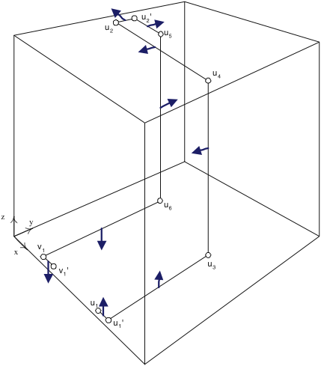
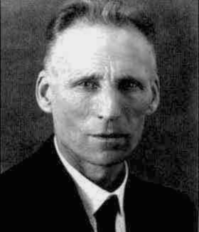
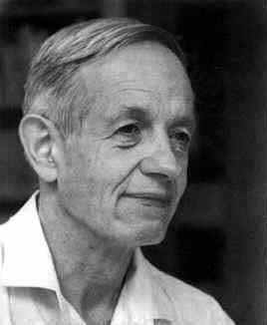
The PLAN
DGP = Daskalakis, Goldberg, Papadimitriou
CD = Chen, Deng
[Pap ’94]
[DGP ’05]
0^{n}
Embed PPAD graph in [0,1]³
...
Generic PPAD
[DGP ’05]
4-player
NASH
[DGP ’05]
[DP ’05]
3-player
NASH
[DGP ’05]
[DGP ’05]
[CD’05]
[CD’06]
2-player
NASH
p.w. linear
BROUWER
multi-player
NASH
3D-SPERNER

Slide 26
Algorithms for computing Nash equilibrium

Slide 27
Support Enumeration Algorithms
How better would my life be if I knew the support of the Nash equilibrium?
… and the game is 2-player?
Setting: Let (R, C) be an m by n game, and suppose a friend revealed to us the supports and respectively of the Row and Column players’ mixed strategies at some equilibrium of the game.
any feasible point (x, y) of the following linear program is an equilibrium!
s.t.
and

Slide 28
Support Enumeration Algorithms
How better would my life be if I knew the support of the Nash equilibrium?
… and the game is 2-player?
Runtime:
for guessing the support
for solving the LP

Slide 29
Support Enumeration Algorithms
How better would my life be if I knew the support of the Nash equilibrium?
… and the game is separable?
input:
the support of every node at equilibrium
goal:
recover the Nash equilibrium with that support
➔ can do this with Linear Programming too!
the idea of why this is possible is similar to the 2-player case:
- the expected payoff of a node from a given pure strategy is linear in the mixed strategies of the other players;
- hence, once the support is known, the equilibrium conditions correspond to linear equations and inequalities.

Slide 30
Rationality of Equilibria
Important Observation:
The correctness of the support enumeration algorithm implies that in 2-player games and in polymatrix games there always exists an equilibrium in rational numbers, and with description complexity polynomial in the description of the game!

Slide 31
Computation of Approximate Equilibria
Theorem [Lipton, Markakis, Mehta ’03]:
For all and any 2-player game with at most n strategies per player and payoff entries in [0,1], there exists an -approximate Nash equilibrium in which each player’s strategy is uniform on a multiset of their pure strategies of size
Proof idea:
(of a stronger claim)
- By Nash’s theorem, there exists a Nash equilibrium (x, y).
- Suppose we take samples from x, viewing it as a distribution.
: uniform distribution over the sampled pure strategies
- Similarly, define by taking t samples from y.
Claim:

Slide 32
Computation of Approximate Equilibria
Suffices to show the following:
Lemma: With probability at least 1-4/n the following are satisfied:
Proof: Chernoff bounds.

Slide 33

Computation of Approximate Equilibria
set :
every point is a pair of mixed strategies that are uniform on a multiset of size
Random sampling from takes expected time
Oblivious Algorithm: set does not depend on the game we are solving.
Theorem [Daskalakis-Papadimitriou ’09] : Any oblivious algorithm for general games runs in expected time

