Slide 1
COMP 553: Algorithmic Game Theory
Lecture 20
Fall 2014
Yang Cai

Slide 2
In last lecture, we showed Nash’s theorem that a Nash equilibrium exists in every game.
In our proof, we used Brouwer’s fixed point theorem as a Black-box.
In today’s lecture, we explain Brouwer’s theorem, and give an illustration of Nash’s proof.
We proceed to prove Brouwer’s Theorem using a combinatorial lemma, called Sperner’s Lemma, whose proof we also provide.

Slide 3
Brouwer’ s Fixed Point Theorem

Slide 4

Brouwer’s fixed point theorem
Theorem: Let f : D D be a continuous function from a convex and compact subset D of the Euclidean space to itself.
Then there exists an x s.t. x = f (x) .
closed and bounded
Below we show a few examples, when D is the 2-dimensional disk.
f
D
D
N.B. All conditions in the statement of the theorem are necessary.

Slide 5
Brouwer’s fixed point theorem
fixed point

Slide 6
Brouwer’s fixed point theorem
fixed point

Slide 7
Brouwer’s fixed point theorem
fixed point

Slide 8
Nash’s Proof

Slide 9
Nash’s Function
where:

Slide 10
Visualizing Nash’s Construction
Kick Dive | Left | Right
Left | 1 , -1 | -1 , 1
Right | -1 , 1 | 1, -1
ƒ: [0,1]² →[0,1]², continuous
such that
fixed points ≡ Nash eq.
Penalty Shot Game

Slide 11
Visualizing Nash’s Construction
0
Pr[Right]
1
0
Kick Dive | Left | Right
Left | 1 , -1 | -1 , 1
Right | -1 , 1 | 1, -1
Pr[Right]
Penalty Shot Game
1

Slide 12
Visualizing Nash’s Construction
0
Pr[Right]
1
0
Kick Dive | Left | Right
Left | 1 , -1 | -1 , 1
Right | -1 , 1 | 1, -1
Pr[Right]
Penalty Shot Game
1

Slide 13
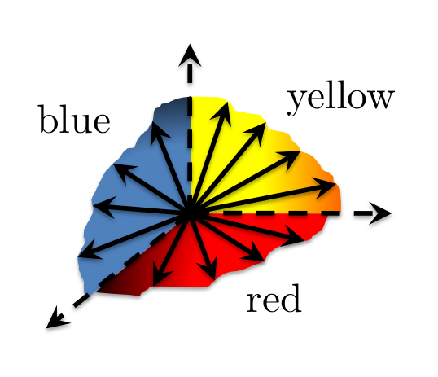
Visualizing Nash’s Construction
0
Pr[Right]
1
0
Kick Dive | Left | Right
Left | 1 , -1 | -1 , 1
Right | -1 , 1 | 1, -1
Pr[Right]
Penalty Shot Game
1

Slide 14
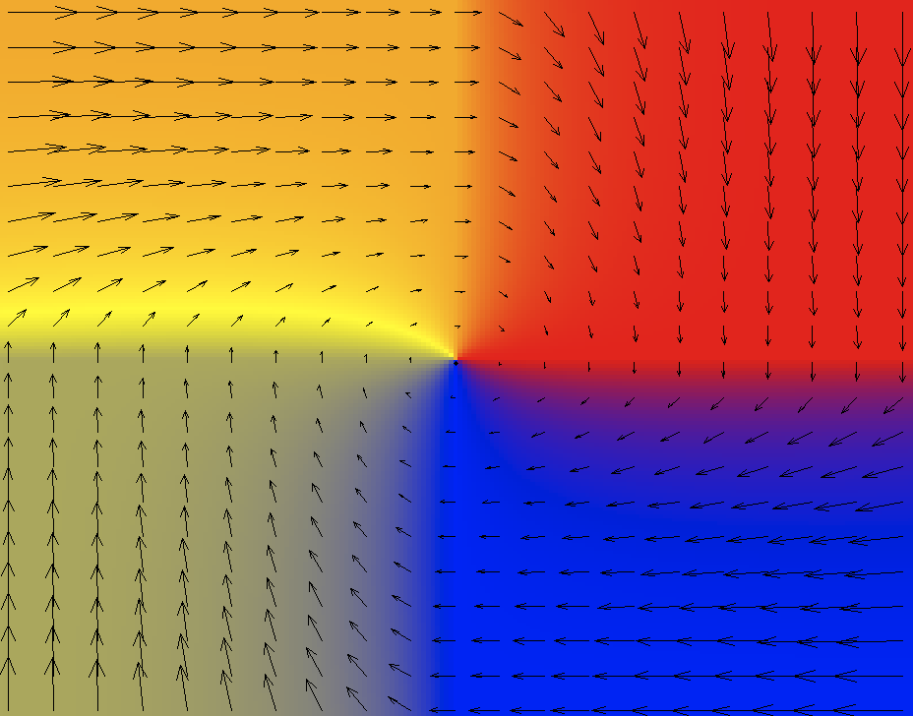
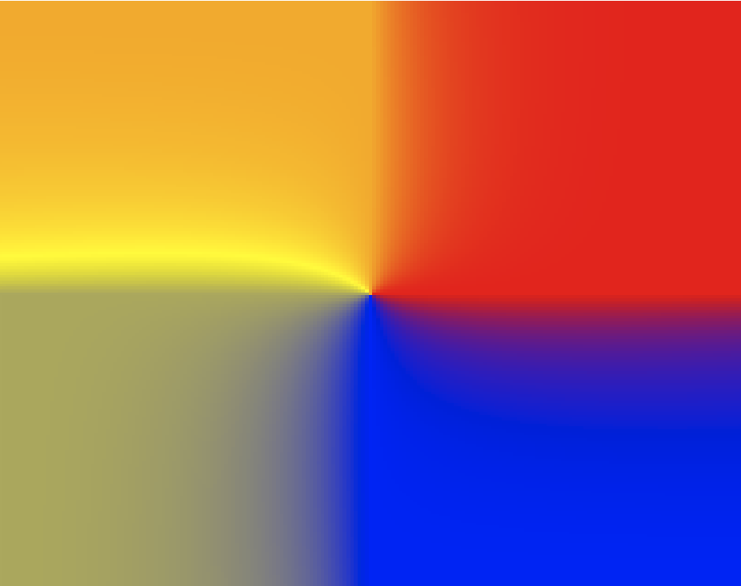
Visualizing Nash’s Construction
0
Pr[Right]
1
½
½
0
Kick Dive | Left | Right
Left | 1 , -1 | -1 , 1
Right | -1 , 1 | 1, -1
ƒ: [0,1]² →[0,1]², cont.
such that
fixed point ≡ Nash eq.
Pr[Right]
½
½
Penalty Shot Game
1
fixed point

Slide 15
Sperner’s Lemma

Slide 16
Sperner’s Lemma

Slide 17
Sperner’s Lemma
no yellow
no blue
no red
Lemma: Color the boundary using three colors in a legal way.

Slide 18
Sperner’s Lemma
no yellow
no blue
no red
Lemma: Color the boundary using three colors in a legal way. No matter how the internal nodes are colored, there exists a tri-chromatic triangle. In fact an odd number of those.

Slide 19
Sperner’s Lemma
Lemma: Color the boundary using three colors in a legal way. No matter how the internal nodes are colored, there exists a tri-chromatic triangle. In fact an odd number of those.

Slide 20
Sperner’s Lemma
Lemma: Color the boundary using three colors in a legal way. No matter how the internal nodes are colored, there exists a tri-chromatic triangle. In fact an odd number of those.

Slide 21
Proof of Sperner’s Lemma
For convenience we introduce an outer boundary, that does not create new tri-chromatic triangles.
Next we define a directed walk starting from the bottom-left triangle.
Lemma: Color the boundary using three colors in a legal way. No matter how the internal nodes are colored, there exists a tri-chromatic triangle. In fact an odd number of those.
Notes:
Think of each triangle as a little room, where each edge is a door that leads you to the next room.

Slide 22
Proof of Sperner’s Lemma
Space of Triangles
Transition Rule:
If ∃ red - yellow door cross it with red on your left hand.
?
₂
₁
Lemma: Color the boundary using three colors in a legal way. No matter how the internal nodes are colored, there exists a tri-chromatic triangle. In fact an odd number of those.

Slide 23
Proof of Sperner’s Lemma
Claim: The walk cannot exit the square, nor can it loop around itself in a rho-shape. Hence, it must stop somewhere inside. This can only happen at tri-chromatic triangle…
For convenience we introduce an outer boundary, that does not create new tri-chromatic triangles.
Next we define a directed walk starting from the bottom-left triangle.
!
Starting from other triangles we do the same going forward or backward.
Lemma: Color the boundary using three colors in a legal way. No matter how the internal nodes are colored, there exists a tri-chromatic triangle. In fact an odd number of those.

Slide 24
Proof of Brouwer’s Fixed Point Theorem
We show that Sperner’s Lemma implies Brouwer’s Fixed Point Theorem. We start with the 2-dimensional Brouwer problem on the square.

Slide 25
2D-Brouwer on the Square
Suppose ƒ: [0,1]² →[0,1]², continuous
must be uniformly continuous (by the Heine-Cantor theorem)
1
0
0
1

Slide 26
2D-Brouwer on the Square
Suppose ƒ: [0,1]² →[0,1]², continuous
must be uniformly continuous (by the Heine-Cantor theorem)
1
choose some and
triangulate so that the diameter of cells is
0
0
1

Slide 27
2D-Brouwer on the Square
Suppose ƒ: [0,1]² →[0,1]², continuous
must be uniformly continuous (by the Heine-Cantor theorem)
color the nodes of the triangulation according to the direction of
1
choose some and
triangulate so that the diameter of cells is
0
0
1

Slide 28
2D-Brouwer on the Square
Suppose ƒ: [0,1]² →[0,1]², continuous
must be uniformly continuous (by the Heine-Cantor theorem)
color the nodes of the triangulation according to the direction of
1
choose some and
triangulate so that the diameter of cells is
tie-break at the boundary angles, so that the resulting coloring respects the boundary conditions required by Sperner’s lemma
find a trichromatic triangle, guaranteed by Sperner
0
0
1

Slide 29
2D-Brouwer on the Square
Suppose ƒ: [0,1]² →[0,1]², continuous
must be uniformly continuous (by the Heine-Cantor theorem)
1
Claim: If z^{Y} is the yellow corner of a trichromatic triangle, then
0
0
1

Slide 30
Proof of Claim
Claim: If z^{Y} is the yellow corner of a trichromatic triangle, then
Proof: Let z^{Y}, z^{R} , z^{B} be the yellow/red/blue corners of a trichromatic triangle.
By the definition of the coloring, observe that the product of
Hence:
1
Similarly, we can show:
0
0
1

Slide 31
2D-Brouwer on the Square
Suppose ƒ: [0,1]² →[0,1]², continuous
must be uniformly continuous (by the Heine-Cantor theorem)
1
Claim: If z^{Y} is the yellow corner of a trichromatic triangle, then
Choosing
0
0
1

Slide 32
2D-Brouwer on the Square
Finishing the proof of Brouwer’s Theorem:
- pick a sequence of epsilons:
- define a sequence of triangulations of diameter:
- pick a trichromatic triangle in each triangulation, and call its yellow corner
- by compactness, this sequence has a converging subsequence
with limit point
Claim:
Proof:
Define the function . Clearly, is continuous since is continuous and so is . It follows from continuity that
But . Hence, . It follows that .
Therefore,

Slide 33
How hard is computing a Nash Equilibrium?

Slide 34
NASH, BROUWER and SPERNER
We informally define three computational problems:
NASH: find a (appx-) Nash equilibrium in a n player game.
BROUWER: find a (appx-) fixed point x for a continuous function f().
SPERNER: find a trichromatic triangle (panchromatic simplex) given a legal coloring.

Slide 35
Function NP (FNP)
A search problem L is defined by a relation R_{L}(x, y) such that
R_{L}(x, y)=1 iff y is a solution to x
A search problem is called total iff for all x there exists y such that R_{L}(x, y) =1.
A search problem L belongs to FNP iff there exists an efficient algorithm A_{L}(x, y) and a polynomial function p_{L}( ⋅ ) such that
(i) if A_{L}(x, z)=1 ➔ R_{L}(x, z)=1
(ii) if ∃ y s.t. R_{L}(x, y)=1 ➔ ∃ z with |z| ≤ p_{L}(|x|) such that A_{L}(x, z)=1
Clearly, SPERNER ∈ FNP.

Slide 36
Reductions between Problems
A search problem L ∈ FNP, associated with A_{L}(x, y) and p_{L} , is polynomial-time reducible to another problem L’ ∈ FNP, associated with A_{L’}(x, y) and p_{L’}, iff there exist efficiently computable functions f, g such that
(i) x is input to L ➔ f(x) is input to L’
(ii)
A_{L’} (f(x), y)=1 ➔ A_{L}(x, g(y))=1
R_{L’} (f(x), y)=0, ∀ y ➔ R_{L}(x, y)=0, ∀ y
A search problem L is FNP-complete iff
e.g. SAT
L ∈ FNP
L’ is poly-time reducible to L, for all L’ ∈ FNP

Slide 37
Our Reductions (intuitively)
NASH
BROUWER
SPERNER
∈ FNP
both Reductions are polynomial-time
Is then SPERNER FNP-complete?
- With our current notion of reduction the answer is no, because SPERNER always has a solution, while a SAT instance may not have a solution;
- To attempt an answer to this question we need to update our notion of reduction. Suppose we try the following: we require that a solution to SPERNER informs us about whether the SAT instance is satisfiable or not, and provides us with a solution to the SAT instance in the ``yes’’ case;
but if such a reduction existed, it could be turned into a non-deterministic algorithm for checking “no” answers to SAT: guess the solution to SPERNER; this will inform you about whether the answer to the SAT instance is “yes” or “no”, leading to
…
- Another approach would be to turn SPERNER into a non-total problem, e.g. by removing the boundary conditions; this way, SPERNER can be easily shown FNP-complete, but all the structure of the original problem is lost in the reduction.

