Slide 1
COMP/MATH 553 Algorithmic Game Theory
Lecture 12: Implementation of the Reduced Forms and the Structure of the Optimal Multi-item Auction
Oct 15, 2014
Yang Cai

Slide 2
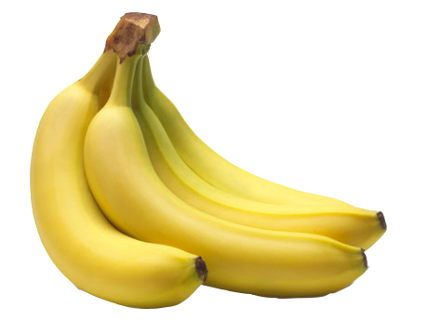

New Decision Variables
Variables: Interim Allocation rule aka. “REDUCED FORM”:
*
: Pr ( )
π_{ij}(v_{i})
j
i
i
valuation v_{i}
*
: E [ price_{i} ]
i
valuation v_{i}

Slide 3
A succinct LP
Variables:
  π_{ij}(v_{i}): probability that item j is allocated to bidder i if her reported valuation (bid) is v_{i} in expectation over every other bidders’ valuations (bids);
  p_{i}(v_{i}) : price bidder i pays if her reported valuation (bid) is v_{i} in expectation over every other bidder’s valuations (bids)
Constraints:
  BIC: for all v_{i} and v’_{i} in T_{i}
  IR: for all v_{i} in T_{i}
  Feasibility: exists an auction with this reduced form.
Objective:
  Expected revenue:

Slide 4
Implementation of a Feasible Reduced Form
After solving the succinct LP, we find the optimal reduced form π* and p*.
Can you turn π* and p* into an auction whose reduced form is exactly π* and p*?
This is crucial, otherwise being able to solve the LP is meaningless.
Will show you a way to implement any feasible reduced form, and it reveals important structure of the revenue-optimal auction!

Slide 5
Implementation of a Feasible Reduced Form

Slide 6
Set of Feasible Reduced Forms
Reduced form is collection ;
Can view it as a vector ;
Let’s call set of feasible reduced forms ;
Claim 1: F(D) is a convex polytope.
Proof: Easy!
  A feasible reduced form is implemented by a feasible allocation rule M.
  M is a distribution over deterministic feasible allocation rules, of which there is a finite number. So: , where is deterministic.
  Easy to see:
  So, F(D) =
convex hull of reduced forms of feasible deterministic mechanisms

Slide 7
Set of Feasible Reduced Forms
F(D)
?
Q:
Is there a simple allocation rule implementing the corners?

Slide 8
* Is there a simple allocation rule implementing a corner?
F(D)
virtual welfare maximizing interim rule when virtual
value functions are the f_{i}’s
------ (1)
expected virtual welfare of an allocation rule with interim rule π’
--- (2)
interpretation: virtual value derived by bidder i when given item j when his type is A

Slide 9
Is there a simple allocation rule implementing a corner?
F(D)
virtual welfare maximizing interim rule when virtual
value functions are the f_{i}’s
?
  Q: Can you name an algorithm doing this?
A: YES, the VCG allocation rule
( w/ virtual value functions f_{i}, i=1,..,m )
= : virtual-VCG( { f_{i} } )
interpretation: virtual value derived by bidder i when given item j when his type is A

Slide 10
Characterization Theorem [C.-Daskalakis-Weinberg]
F(D) is a Convex Polytope whose corners are implementable by virtual VCG allocation rules.
How about implementing any point inside F(D)?
F(D)

Slide 11
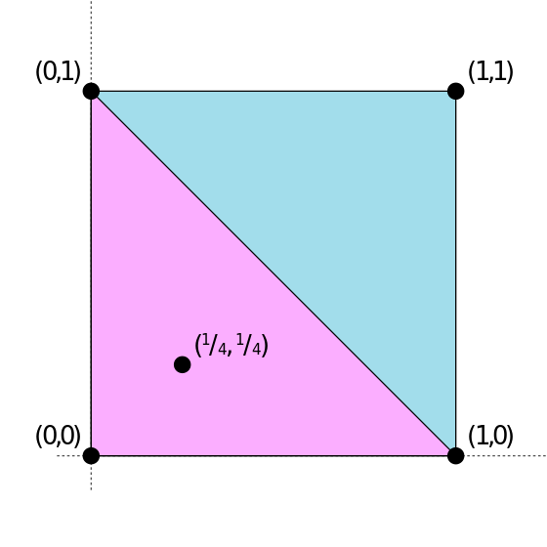
Carathéodory’s theorem
If some point x is in the convex hull of P then
Carathéodory’s Theorem: If a point x of R^{d} lies in the convex hull of a set P, there is a subset P′ of P consisting of d + 1 or fewer points such that x lies in the convex hull of P′.
For example:
x = ¼(0,1) + ¼(1,0) + ½(0,0)

Slide 12
Characterization Theorem [C.-Daskalakis-Weinberg]
Any point inside F(D) is a convex combination (distribution) over the corners.
The interim allocation rule of any feasible mechanism can be implemented as a distribution over virtual VCG allocation rules.
F(D)

Slide 13
Structure of the Optimal Auction

Slide 14

Characterization of Optimal Multi-Item Auctions
Theorem [C.-Daskalaks-Weinberg]: Optimal multi-item auction has the following structure:
Bidders submit valuations (t₁,…,t_{m}) to auctioneer.
Auctioneer samples virtual transformations f₁,…, f_{m}
Auctioneer computes virtual types t’_{i} = f_{i}(t_{i})
Virtual welfare maximizing allocation is chosen.
    Namely, each item is given to bidder with highest virtual value for that item (if positive)
Prices are charged to ensure truthfulness.

Slide 15
Characterization of Optimal Multi-Item Auctions
Theorem [C.-Daskalaks-Weinberg]: Optimal multi-item auction has the following structure:
Bidders submit valuations (t₁,…,t_{m}) to auctioneer.
Auctioneer samples virtual transformations f₁,…, f_{m}
Auctioneer computes virtual types t’_{i} = f_{i}(t_{i})
Virtual welfare maximizing allocation is chosen.
    Namely, each item is given to bidder with highest virtual value for that item (if positive)
Prices are charged to ensure truthfulness.
Exact same structure as Myerson!
    in Myerson’s theorem: virtual function = deterministic
    here, randomized (and they must be)

Slide 16
Interesting Open Problems
Another difference: in Myerson’s theorem: virtual function is given explicitly, in our result, the transformation is computed by an LP. Is there any structure of our transformation?
In single-dimensional settings, the optimal auction is DSIC. In multi-dimensional settings, this is unlikely to be true. What is the gap between the optimal BIC solution and the optimal DSIC solution?

