Slide 1
COMP/MATH 553 Algorithmic Game Theory Lecture 2: Myerson’s Lemma
Sep 8, 2014
Yang Cai

Slide 2
An overview of the class
Broad View: Mechanism Design and Auctions
First Price Auction
Second Price/Vickrey Auction
Case Study: Sponsored Search Auction

Slide 3
[1] Broader View
Mechanism Design (MD)
Auction

Slide 4
?
What is Mechanism Design?
It’s the Science of Rule Making.

Slide 5
What is Mechanism Design?
Most of Game Theory/Economics devoted to
Understanding an existing game/economic system.
Explain/predict the outcome.
Mechanism Design − reverse the direction
Identifies the desired outcome/goal first!
Asks whether the goals are achievable?
If so, how?
“Engineering” part of Game Theory/Economics
Existing
System
Outcome
Predict
Achievable?
Goal
System
Mechanism Design
Notes:
Predicate the outcome, e.g. the study of Nash equilibrium

Slide 6
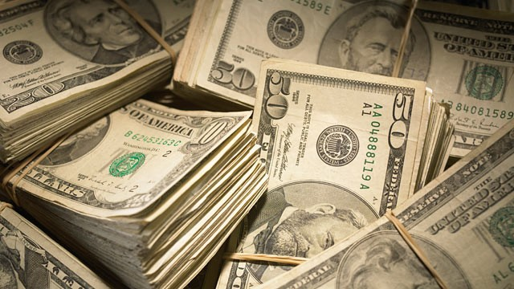
Auctions
Mechanism Design
Auctions
MD
Elections, fair division, etc. (will cover if time permits)
Auction
[1] Broader View
Notes:
Course registration. School admission.

Slide 7
Auction example 1 − Online Marketplace
MD
Auction
[1] Broader View

Slide 8
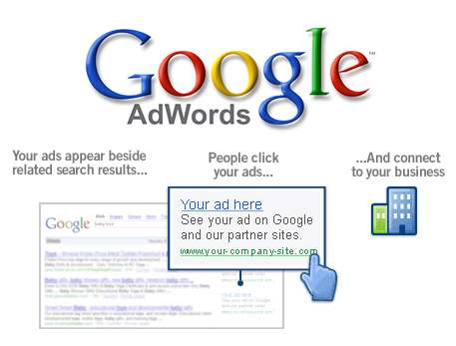
Auction example 2 − Sponsored Search
MD
Auction
[1] Broader View

Slide 9
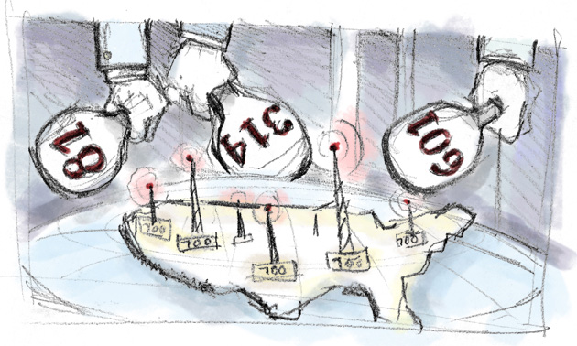
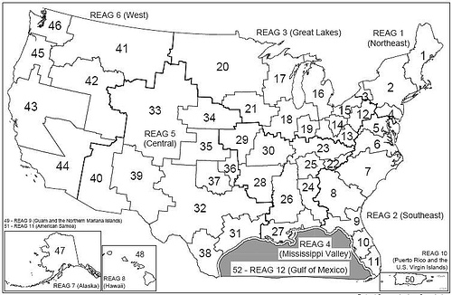
Auction example 3 − Spectrum Auctions
MD
Auction
[1] Broader View
Notes:
Government wants to sell the license for transmitting signals over some bands in the electromagnetic spectrum. Helps allocate the bands to companies that value them the most, and generates huge revenue for the government.
Use auction to sell spectrum
Canada 2008, 4.25 billions. Took two months for the auction to complete. 2014, 5.3 billions.
United states, FCC (Federal communication commission) since 94, has conducted 87 auctions. Raised over 60 billions

Slide 10
Single item auction

Slide 11
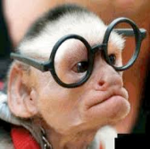
Single-item Auctions: Set-up
Bidders
Auctioneer
1
v₁
Item
…
i
v_{i}
…
n
Bidders:
have values on the item.
These values are Private.
Quasilinear utility:
v_{i} – p, if wins.
0, if loses.
v_{n}

Slide 12
Auction Format: Sealed-Bid Auction
Bidders
1
v₁
Auctioneer
Item
…
i
v_{i}
…
n
v_{n}
Sealed-Bid Auctions:
Each bidder i privately communicates a bid b_{i} to the auctioneer — in a sealed envelope, if you like.
The auctioneer decides who gets the good (if anyone).
The auctioneer decides on a selling price.

Slide 13
Auction Format: Sealed-Bid Auction
Bidders
1
v₁
Auctioneer
Item
…
i
v_{i}
…
n
v_{n}
Sealed-Bid Auctions:
Each bidder i privately communicates a bid b_{i} to the auctioneer — in a sealed envelope, if you like.
The auctioneer decides who gets the good (if anyone).
The auctioneer decides on a selling price.
Goal: Maximize social welfare. (Give it to the bidder with the highest value)
Natural Choice: Give it to the bidder with the highest bid.
The only selection rule we use in this lecture.

Slide 14
Auction Format: Sealed-Bid Auction
Bidders
1
v₁
Auctioneer
Item
…
i
v_{i}
…
n
v_{n}
Sealed-Bid Auctions:
Each bidder i privately communicates a bid b_{i} to the auctioneer — in a sealed envelope, if you like.
The auctioneer decides who gets the good (if anyone).
The auctioneer decides on a selling price.
How about the selling price?

Slide 15
Auction Format: Sealed-Bid Auction
How about the selling price?
Altruistic and charge nothing?
Name the largest number you can...
Fails terribly...

Slide 16
First Price Auction
Pay you bid (First Price)?
Hard to reason about.
What did you guys bid?
For two bidders,each bidding half of her value is a Nash eq. Why?

Slide 17
First Price Auction Game played last time
Assume your value v_{i} is sampled from U[0,1].
You won’t overbid, so you will discount your value. Your strategy is a number d_{i} in [0,1] which specifies how much you want to discount your value, e.g. b_{i} = (1−d_{i}) v_{i}
Game 1: What will you do if you are playing with only one student (picked random) from the class?
Game 2: Will you change your strategy if you are playing with two other students? If yes, what will it be?

Slide 18
First Price Auction
Pay you bid (First Price)?
For two bidders,each bidding half of her value is a Nash eq. Why?
How about three bidders? n bidders?
Discounting a factor of 1/n is a Nash eq.

Slide 19
First Price Auction
Pay you bid (First Price)?
What if the values are not drawn from U[0,1], but from some arbitrary distribution F?
b_{i}(v) = E[max_{j≠i} v_{j} | v_{j} ≤ v ]
What if different bidders have their values drawn from different distributions?
Eq. strategies could get really complicated...

Slide 20
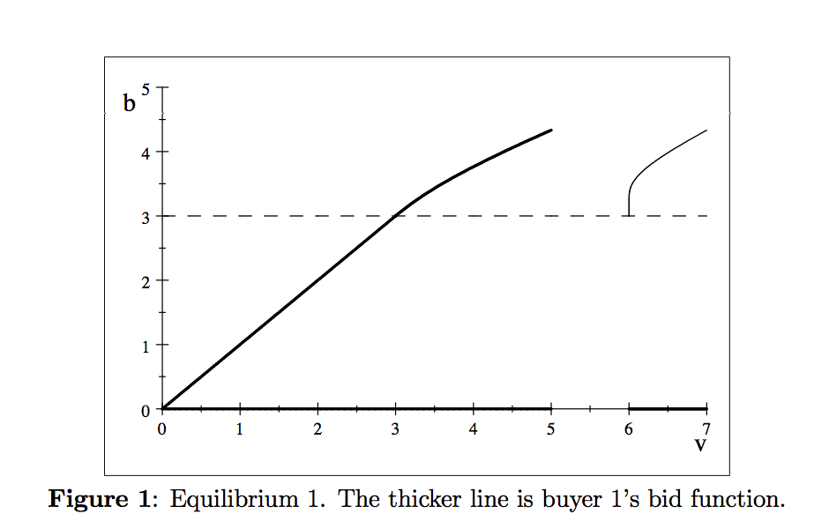
First Price Auction
Example [Kaplan and Zamir ’11]: Bidder 1’s value is drawn from U[0,5], bidder 2’s value is drawn from U[6,7].

Slide 21
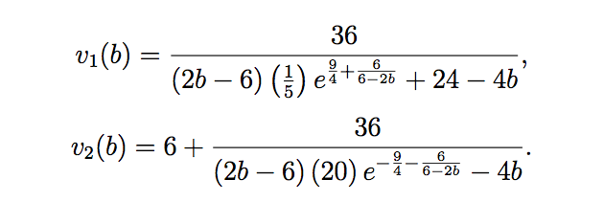
First Price Auction
Example [Kaplan and Zamir ’11]: Bidder 1’s value is drawn from U[0,5], bidder 2’s value is drawn from U[6,7].
Nash eq. : bidder 1 bids 3 if his value is in [0,3], otherwise for b in (3, 13/3]:

Slide 22
First Price Auction
Pay you bid (First Price)?
Depends on the number of bidders.
Depends on your information about other bidders.
Optimal bidding strategy complicated!
Nash eq. might not be reached.
Winner might not value the item the most.

Slide 23
Second Price/Vickrey Auction
Another idea
Charge the winner the second highest bid.
Seems arbitrary...
But actually used in Ebay.

Slide 24
Second-Price/Vickrey Auction
Lemma 1: In a second-price auction, every bidder has a dominant strategy: set its bid b_{i} equal to its private valuation v_{i}. That is, this strategy maximizes the utility of bidder i, no matter what the other bidders do.
Super easy to participate in. (unlike first price)
Proof: See the board.

Slide 25
Second-Price/Vickrey Auction
Lemma 2: In a second-price auction, every truthful bidder is guaranteed non-negative utility.
Proof: See the board.

Slide 26
Second Price/Vickrey Auction
[Vickrey ’61 ] The Vickrey auction is has three quite different and desirable properties:
[strong incentive guarantees] It is dominant-strategy incentive-compatible (DSIC), i.e., Lemma 1 and 2 hold.
(2) [strong performance guarantees] If bidders report truthfully, then the auction maximizes the social welfare Σ_{i} vixi,
where xi is 1 if i wins and 0 if i loses.
(3) [computational efficiency] The auction can be implemented in polynomial (indeed linear) time.

Slide 27
What’s next?
These three properties are criteria for a good auction:
More complicated allocation problem
Optimize Revenue

Slide 28
Case Study: Sponsored Search Auction

Slide 29
Sponsored Search Auction

Slide 30
In 2012, sponsored search auction generates 43.6 billion dollars for Google, which is 95% of its total revenue. In the meantime, the market grows by 20% per year.

Slide 31
Sponsored Search Auctions: Set-up
Bidders (advertisers)
Slots
Auctioneer/Google
1
v₁
α₁
1
…
…
i
v_{i}
α_{j}
j
…
…
n
v_{n}
α_{k}
k
k slots for sale.
Slot j has click-through-rate (CTR) α_{j}.
Bidder i’s value for slot j is α_{j}v_{i}.
Two complications:
Multiple items
Items are non identical

Slide 32
Sponsored Search Auction: Goal
DSIC. That is, truthful bidding should be a dominant strategy, and never leads to negative utility.
(2) Social welfare maximization. That is, the assignment of bidders to slots should maximize Σvixi,
where xi now denotes the CTR of the slot to which i is assigned (or 0 if i is not assigned to a slot). Each slot can only be assigned to one bidder, and each bidder gets only one slot.
(3) Polynomial running time. Remember zillions of these auctions need to be run every day!

