Slide 1
COMP/MATH 553: Algorithmic Game Theory
Lecture 1
Fall 2014
Yang Cai
www.cs.mcgill.ca/~cai

Slide 2
game theory society sign
what we won’t study in this class…

Slide 3

I only mean this as a metaphor of what we usually study in Eng.:
- central design
- cooperative components
- rich theory

Slide 4
game theory society sign
what we will study in this class…

Slide 5
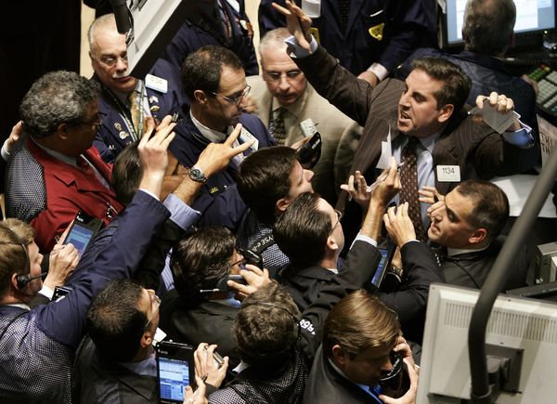
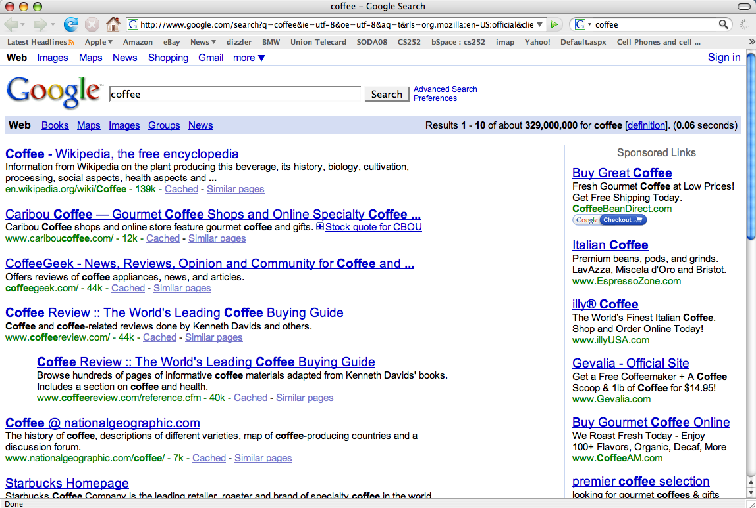
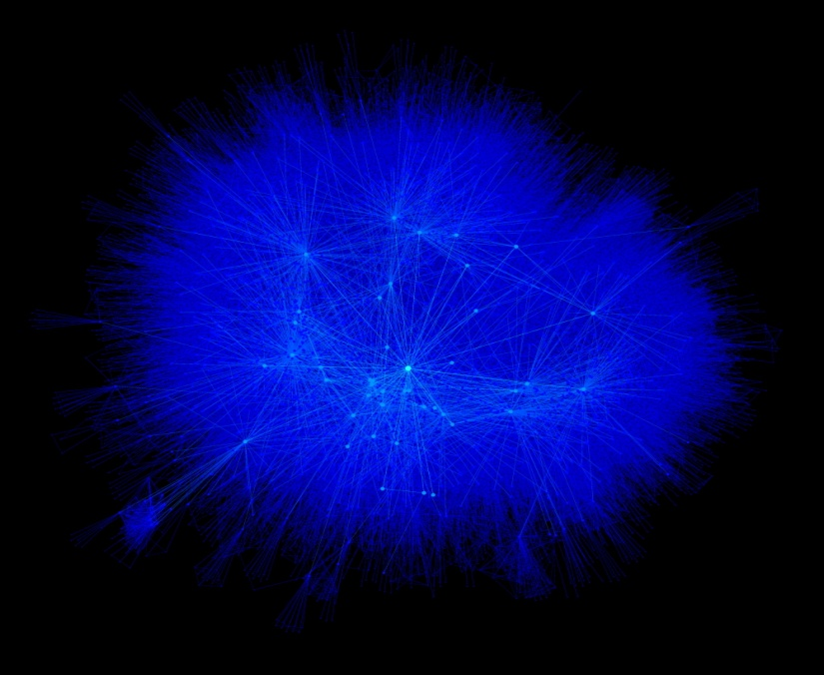
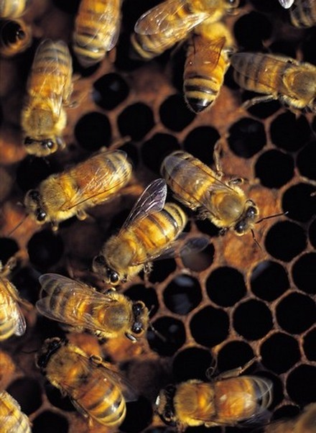


Markets
Routing in Networks
Online Advertisement
Evolution
Social networks
Elections

Slide 6
Game Theory
- central design ?
- cooperative components ?
- rich theory ?
we will study (and sometimes question) the algorithmic foundations of this theory
Notes:
Indeed, if we are going to use this theory to design systems (routing protocols, ad platforms, etc.) we should understand the algorithmic foundations of the theory.

Slide 7
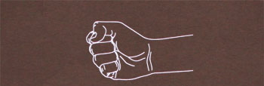


Game Theory
1/3
1/3
1/3
0,0 | -1,1 | 1,-1
1,-1 | 0,0 | -1 , 1
-1,1 | 1 , -1 | 0,0
1/3
1/3
1/3

Slide 8
Game Theory
Games are thought experiments to help us learn how to predict rational behavior in situations of conflict.
Rational Behavior: a player will always prefer to improve her station regardless of the consequences.
Encoded via a utility function.
Players want to maximize their own expected utility.
Much of the “irrationality” can also be incorporated ...
Assume other people are as smart or smarter than you ...

Slide 9
Game Theory
Games are thought experiments to help us learn how to predict rational behavior in situations of conflict.
Situation of conflict: Everybody's actions affect others.
- In traditional optimization, the goal is optimizing a single objective.
In game theory, every player has a utility function to optimize.
The output depends on the player’s own choice and the choices of the others.

Slide 10
Game Theory
Games are thought experiments to help us learn how to predict rational behavior in situations of conflict.
Predict: We want to know what happens in a game. Such predictions are called solution concepts (e.g., Nash equilibrium).

Slide 11
Algorithmic Game Theory
1/3
1/3
1/3
Mechanism Design: How can we design a system that will be launched and used by competitive users to optimize our objectives ?
1/3
0,0 | -1,1 | 1,-1
1,-1 | 0,0 | -1 , 1
-1,1 | 1 , -1 | 0,0
1/3
?
1/3
Can we predict what will happen in a large system?
Game theory says yes, through its prediction tools (solution concepts).
Can we efficiently predict what will happen in a large system?
Are the predictions of Game Theory plausible, i.e. likely to arise?
Notes:
Notice that these questions are algorithmic questions.

Slide 12
An overview of the class
Administration
Solution Concepts
Equilibrium Computation
Price of Anarchy
Mechanism Design

Slide 13
An overview of the class
Administration
Solution Concepts
Equilibrium Computation
Price of Anarchy
Mechanism Design

Slide 14
Administrivia
TA: Liana Yepremyam (Office Hours: consult webpage )
Attendance/Evaluation:
Everybody is welcome
Requirements, if registered for credit):
- Class attendance and participation (play a few games in class)
- Scribe one lecture
- Solve problem sets: 3-4 problems sets, two weeks to solve.
- Final exam or Project: let me know by mid-October
- Project
Survey or Research;
Encouraged to do original research, apply ideas from this class to your own area of interest, work in groups;
Project proposal due in mid-October.
If just auditing:
- Become a listener. Why not?

Slide 15
An overview of the class
Administration
Solution Concepts
Equilibrium Computation
Price of Anarchy
Mechanism Design

Slide 16
Battle of the Sexes
 | Theater! | Football fine
Theater fine | 1, 5 | 0, 0
Football! | 0, 0 | 5, 1
Think of this game as a metaphor of real-life examples, not necessarily in the context of a couple’s decision making, not necessarily about football vs theater, and not necessarily with exactly these numerical values associated to different outcomes.
Nash Equilibrium: A pair of strategies (deterministic or randomized) such that the strategy of the row player is a Best Response to the strategy of the column player and vice versa.
Aims to capture the behavioral norms to which a society where this game occurs may converge.

Slide 17
Battle of the Sexes
5/6
1/6
 | Theater! | Football fine
Theater fine | 1, 5 | 0, 0
Football! | 0, 0 | 5, 1
1/6
5/6
Think of this game as a metaphor of real-life examples, not necessarily in the context of a couple’s decision making, not necessarily about football vs theater, and not necessarily with exactly these numerical values associated to different outcomes.
Nash Equilibrium: A pair of strategies (deterministic or randomized) such that the strategy of the row player is a Best Response to the strategy of the column player and vice versa.
Aims to capture the behavioral norms to which a society where this game occurs may converge.
(Theater fine, Theater!)
Matriarchic society
(Football!, Football fine)
Patriarchic society
In medias res: There is always an odd number of Nash Equilibria
Notes:
Pure vs Mixed Nash equiibria
Ex: verify that the (5/6 1/6) randomization is a Nash Equilibrium.

Slide 18
Remark:
Matrix-form games intend to model repeated occurrences of the same conflict, provided that there are no strategic correlations between different occurrences of the game. If such correlations exist, we exit the realm of matrix-form games, entering the realm of repeated games.
How can repeated occurrences happen without inter-occurrence correlations?
Imagine a population of blue players (these are the ones preferring football) and orange players (these are those preferring theater). Members of the blue population encounter members of the orange population at random and need to decide whether to watch football or theater.
What do the Nash equilibria represent?
The Nash equilibria predict what types of behaviors and (in the case of randomized strategies) at what proportions will arise in the two populations at the steady state of the game.

Slide 19
Battle of the Sexes
Suppose now that the blue player removes a strategy from his set of strategies and introduces another one:
 | Theater! | Football fine
Theater fine | 1, 5 | 0, 0
Football! | 0, 0 | 5, 1
Theater great, I’ll invite my mom | 2, -1 | 0, 0
unique Equilibrium
(Football!, Football fine)
Moral of the story:
The player who knows game theory managed to eliminate her unwanted Nash equilibrium from the game.

Slide 20
Back to Rock-Paper-Scissors
1/3
1/3
1/3
1/3
0,0 | -1,1 | 1,-1
1,-1 | 0,0 | -1 , 1
-1,1 | 1 , -1 | 0,0
1/3
1/3
The unique Nash Equilibrium is the pair of uniform strategies.
Contrary to the battle of the sexes, in RPS randomization is necessary to construct a Nash equilibrium.

Slide 21
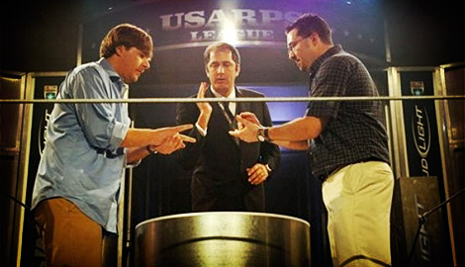
Rock-Paper-Scissors Championship
The behavior observed in the RPS championship is very different from the pair of uniform strategies; indeed, the matrix-form version of RPS did not intend to capture the repeated interaction between the same pair of players---recall earlier remark; rather the intention is to model the behavior of a population of, say, students in a courtyard participating in random occurrences of RPS games

Slide 22
Guess Two-Thirds of the Average
- k players p₁, p₂, p₃, …, p_{k}
- each player submits a number in [0,100]
- compute
Let’s Play!
- find x_{j}, closest to
- player p_{j} wins $100, all other players win nothing

Slide 23
Guess Two-Thirds of the Average
Is it rational to play above ?
A: no (why?)
Given that no rational player will play above is it rational to play above ?
A: no (same reasons)
…
All rational players should play 0.
The all-zero strategy is the only Nash equilibrium of this game.
Rationality versus common knowledge of rationality
historical facts:
21.6 was the winning value in a large internet-based competition organized by the Danish newspaper Politiken. This included 19,196 people and with a prize of 5000 Danish kroner.

Slide 24
OK, Nash equilibrium makes sense and is stable, but does it always exist?

Slide 25
2-player Zero-Sum Games
1/3
1/3
1/3
1/3
0,0 | -1,1 | 1,-1
1,-1 | 0,0 | -1 , 1
-1,1 | 1 , -1 | 0,0
1/3
1/3
Danzig ’47
von Neumann ’28:
In two-player zero-sum games, it always exists.
LP duality
[original proof used analysis]

Slide 26

Poker
von Neuman’s predictions are in fact accurate in predicting players’ strategies in two-player poker!

Slide 27
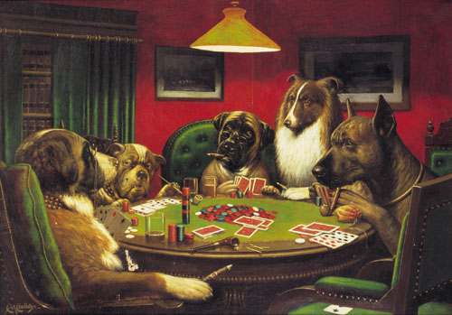
Poker
von Neuman’s predictions are in fact accurate in predicting players’ strategies in two-player poker!
But what about larger systems (more than 2 players) or systems where players do not have directly opposite interests?

Slide 28
Markets
Routing in Networks
?
Online Advertisement
Evolution
Social networks
Elections

Slide 29
Modified Rock Paper Scissors
Not zero-sum any more
25%
50%
25%
0,0 | -1, 1 | 2,-1
1,-1 | 0,0 | - 1 , 1
- 2, 1 | 1 , -1 | 0,0
33%
Is there still an equilibrium?
[that is a pair of randomized strategies so that no player has incentive to deviate given the other player’s strategy ? ]
33%
33%
John Nash ’51:
There always exists a Nash equilibrium, regardless of the game’s properties.
Nobel 1994, due to its large influence in understanding systems of competitors…
Notes:
(Ex): Verify that the mixed strategies shown above are a Nash equilibrium.

Slide 30
Markets
Routing in Networks
and every other game!
Evolutionary Biology
Elections
Social Networks

Slide 31
Applications…
game =
market
price equilibrium
Internet
packet routing
roads
traffic pattern
facebook,
twitter, linkedin, …
structure of the social network

Slide 32
Modified Rock Paper Scissors
Not zero-sum any more
25%
50%
25%
Highly Non- Constructive
0,0 | -1, 1 | 2,-1
1,-1 | 0,0 | - 1 , 1
- 2, 1 | 1 , -1 | 0,0
33%
Is there still an equilibrium?
[that is a pair of randomized strategies so that no player has incentive to deviate given the other player’s strategy ? ]
33%
33%
John Nash ’51:
There always exists a Nash equilibrium, regardless of the game’s properties.
Brouwer’s Fixed Point Theorem
Nobel 1994

Slide 33
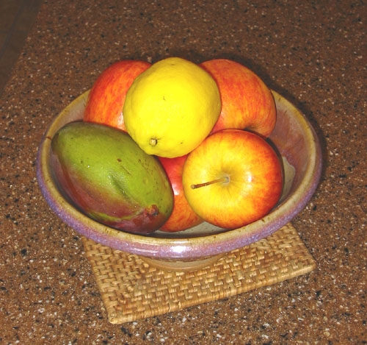
How can we compute a
Nash equilibrium?
- if we had an algorithm for equilibria we could predict what behavior will arise in a system, before the systems is launched
- in this case, we can easily compute the equilibrium, thanks to gravity!
Notes:
But what if there is no gravity to help us?

Slide 34
An overview of the class
Administration
Solution Concepts
Equilibrium Computation
Price of Anarchy
Mechanism Design

Slide 35
2-player zero-sum vs General Games
1928 Neumann:
1950 Nash:
- existence of min-max equilibrium in 2-player, zero-sum games;
- existence of an equilibrium in multiplayer, general-sum games;
- proof uses analysis;
- Proof uses Brouwer’s fixed point theorem;
+ Danzig ’47: equivalent to LP duality;
- intense effort for equilibrium computation algorithms:
+ Khachiyan’79: poly-time solvable;
Kuhn ’61, Mangasarian ’64, Lemke-Howson ’64, Rosenmüller ’71, Wilson ’71, Scarf ’67, Eaves ’72, Laan-Talman ’79, etc.
+ a multitude of distributed algorithms converge to equilibria.
- Lemke-Howson: simplex-like, works with LCP formulation;
no efficient algorithm is known after 50+ years of research.
hence, also no efficient dynamics …

Slide 36
“Is it NP-complete to find a Nash equilibrium?”
the Pavlovian reaction

Slide 37
Why should we care about the complexity of equilibria?
First, if we believe our equilibrium theory, efficient algorithms would enable us to make predictions:
Herbert Scarf writes…
‘‘[Due to the non-existence of efficient algorithms for computing equilibria], general equilibrium analysis has remained at a level of abstraction and mathematical theoretizing far removed from its ultimate purpose as a method for the evaluation of economic policy.’’
The Computation of Economic Equilibria, 1973
More importantly: If equilibria are supposed to model behavior, computa-tional tractability is an important modeling prerequisite.
“If your laptop can’t find the equilibrium, then how can the market?”
Kamal Jain, EBay
N.B. computational intractability implies the non-existence of efficient dynamics converging to equilibria; how can equilibria be universal, if such dynamics don’t exist?

Slide 38
“Is it NP-complete to find a Nash equilibrium?”
the Pavlovian reaction
- the theory of NP-completeness does not seem
appropriate;
NP-complete
- in fact, NASH seems to lie below NP-complete;
NP
- Stay tuned! we are going to answer this question later this semester
P

Slide 39
An overview of the class
Administration
Solution Concepts
Equilibrium Computation
Price of Anarchy
Mechanism Design

Slide 40
Traffic Routing
Delay is 1.5 hours for everybody at the unique Nash equilibrium
50
Town A
Town B
50
Suppose 100 drivers leave from town A towards town B.
Every driver wants to minimize her own travel time.
What is the traffic on the network?
In any unbalanced traffic pattern, all drivers on the most loaded path have incentive to switch their path.
Notes:
(Ex): Verify that the 50-50 split is the unique Nash equilibrium of the system shown above.

Slide 41
Traffic Routing
Delay is 2 hours for everybody at the unique Nash equilibrium
100
Town A
Town B
A benevolent mayor builds a superhighway connecting the fast highways of the network.
What is now the traffic on the network?
No matter what the other drivers are doing it is always better for me to follow the zig-zag path.

Slide 42
Traffic Routing
50
100
A
B
vs
A
B
50
Adding a fast road on a road-network is not always a good idea!
Braess’s paradox
In the RHS network there exists a traffic pattern where all players have delay 1.5 hours.
Price of Anarchy:
measures the loss in system performance due to free-will

Slide 43
Traffic Routing
Obvious Questions:
What is the worst-case PoA in a system?
How do we design a system whose PoA is small?
In other words, what incentives can we provide to induce performance that is close to optimal?
E.g. tolls?

Slide 44
An overview of the class
Administration
Solution Concepts
Equilibrium Computation
Price of Anarchy
Mechanism Design

Slide 45
Mechanism Design
Understand how to design systems with strategic participants that have good performance guarantees
Let’ start with a poorly designed system...
Biggest scandal in 2012 London Olympics
  Women’s badminton double
  No failed drug test
  Failed tournament design

Slide 46

2012 London Olympics Scandal
A
C
B
D
1st:XY?
2nd:KH?
1st
2nd
1st
2nd
1st: PJ
2nd: QW

Slide 47
2012 London Olympics Scandal
Four teams are disqualified, due to “not using one’s best effort to win a game”
Ironically, they are using their best effort to win a Olympic medal
System rule matters: poorly designed systems suffer from unexpected and undesirable results
To quote Hartline and Kleinberg:
“The next time we bemoan people exploiting loopholes to subvert the intent of the rule makers, instead of asking ’What’s wrong with these people?” let’s instead ask, ’What’s wrong with the rules?’ and then adopt a scientifically principled approach to fixing them.”

Slide 48
Auctions
- Suppose we have one item for sale;
- k parties (or bidders) are interested in the item;
- party i has value v_{i} for the item, which is private, and our objective is to give the item to the party with the largest value (alternatively make as much revenue as possible from the sale);
- we ask each party for a bid, and based on their bids b₁, b₂,…, b_{k} we decide who gets the item and how much they pay;
if bidder i gets the item and pays price p, her total utility is v_{i} – p (quasilinear)

Slide 49
Auctions
First Price Auction:
Give item to bidder with largest b_{i}, and charge him b_{i}
clearly a bad idea to bid above your value (why?)
but you may bid below your value (and you will!)
e.g. two bidders with values v₁ = $5, v₂ = $100
Nash equilibrium = (b₁, b₂) = ($5, $5.01) (assume bids are in increments of cents)
- bidders want to place different bids, depending on their opponents’ bids, which they don’t know a priori; hence cycling may occur while they are trying to learn/guess them, etc.
Let’s Play it!
- it is non-obvious how to play
- in the end, the auctioneer does not learn people’s true values

Slide 50
Frist Price Auction Game
Assume your value v_{i} is sampled from U[0,1].
You won’t overbid, so you will discount your value. Your strategy is a number d_{i} in [0,1] which specifies how much you want to discount your value, e.g. b_{i} = (1−d_{i}) v_{i}
Game 1: What will you do if you are playing with only one student (picked random) from the class?
Game 2: Will you change your strategy if you are playing with two other students? If yes, what will it be?

Slide 51
In conclusion
We are going to study and question the algorithmic foundations of Game Theory
Mechanism Design
auctions
Complexity of finding equilibria
NP-completeness theory not relevant, new theory below NP…
Models of strategic behavior
dynamics of player interaction:
e.g. best response, exploration-exploitation,…
Price of Anarchy
Network routing.

