Slide 1

Computer Science Program Orientation
Prof. Joseph Vybihal jvybihal@cs.mcgill.ca
Liette Chin liette.chin@mcgill.ca
Teresa (Tess) Pian teresa.pian@mcgill.ca
August 2022
Notes:
Are your classroom colors different than what you see in this template? That’s OK! Click on Design -> Variants (the down arrow) -> Pick the color scheme that works for you!
Feel free to change any “You will…” and “I will…” statements to ensure they align with your classroom procedures and rules!

Slide 2

CS Program Organization
A common set of Core courses (for all Majors, Minors, and Joint programs), covering basic programming, algorithms, and math.
A set of Complementary courses to choose from, which give flexibility to specialize.
Graphics, databases, AI, networks, and more!
Beyond core and complementary courses, Elective courses – electives can be taken in (almost) any department.
You can take more CS courses, general interest courses, all kinds of things.

Slide 3

First CS Course at McGill
If you have programmed before, in any programming language, take COMP 250
If you have never programmed before, take COMP 202 or COMP 204 or COMP 208
NOTE: COMP 202/204/208 cannot be taken for credit after you have taken COMP 250. And it does NOT make sense to take them at the same time (and you cannot get credit for both if you do it).

Slide 4
COMP 202/204/208 Which one is right for me?
All of them cover roughly the same material, using Python.
COMP 202: can be taken by any student at McGill
Only requires CEGEP level (or grade 12 level) math background
Students doing a B.Sc. can take it as a Complementary course in the Freshman Science Program.
COMP 204: can be taken by students with a background in life sciences
BIOL 112 is a prerequisite, and you have to be comfortable with the basics of cell biology and genetics.
COMP 208: part of several B.Eng. and some B.Sc. programs in the physical sciences
MATH 141 (Calculus 2) is a prerequisite and MATH 133 (Linear Algebra and Geometry) is a co-requisite.

Slide 5

What courses should I choose in U1?
*NOTE: unless you have credits from IB/AP/CEGEP, you will start your first year as a U0 doing the 30-credit Freshman Program. Your second year will be U1.

Slide 6

First, a word about workload
1 credit in a course translates to about 3 hours of work per week
3 credit course = average workload of 9 hours a week (including class time)
Taking 5 courses with 3 credits each means 45 hours of work per week!
Many students take 4 courses (about 36 hours per week) to have time for extra-curriculars, clubs, etc.
Not all courses are the same difficulty – a higher course number does not necessarily mean the course is more difficult, just that it requires more background
Many CS courses involve programming assignments or projects, which can be time consuming
Overall, be aware of your limits and don’t overload and overwork yourself in a semester. You need time to live!

Slide 7

Second, a word about ‘vision’
If you know what you want to do when you leave McGill, then:
Look at the 400-level and 500-level courses you would like to take, and work backwards looking at prerequisite 200-level and 300-level courses
You will see a path emerge for the courses you should take to get there!

Slide 8
U1: No Prior Programming
FALL: COMP 202/ 204/ 208 + Math courses (like 240, 222, 223, and/or 323) + electives (like COMP 330 or classes for a Minor)
Take MATH 240 early, it is a prerequisite for core course COMP 251**
WINTER: COMP 250 and/or COMP 206 + Math + electives

Slide 9
U1: Prior Programming Experience
FALL: COMP 250 + COMP 206 + Math and electives (take MATH 240 early!)
WINTER: COMP 251 + COMP 273 + more Math and/or electives

Slide 10
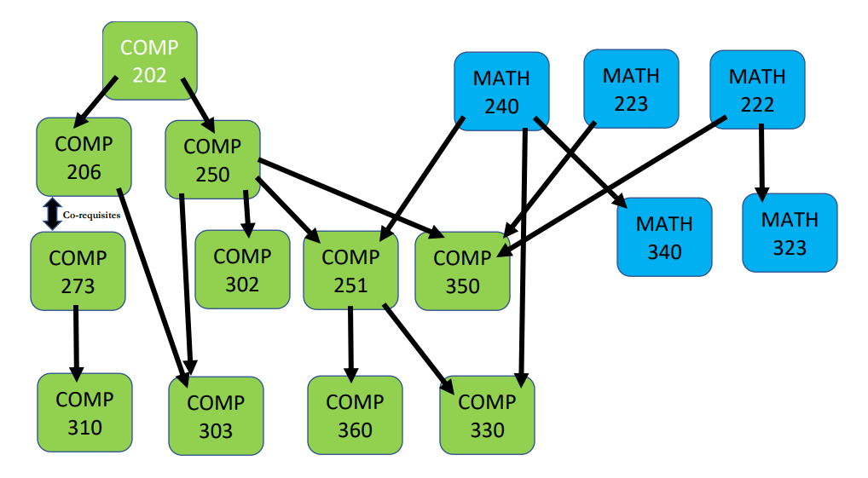
Understanding Important Core/Complementary Course Prerequisites*
*Prerequisite is a course that you must have taken in order to take another course.
Ex. COMP 250 teaches you necessary knowledge for COMP 251, so you have to take COMP 250 before you can take COMP 251.

Slide 11

CS Programs
& Degree Options

Slide 12

Major vs. Honours vs. Liberal Prog.
Computer Science or Software Engineering Major (63 credits)
CS Honours (75 credits)
Honours courses have a few different required courses, a research project, and require more CS credits
GPA must always be 3.0 or above
CS Liberal Program (45 credits)
Liberal Program in Software Engineering (49 credits)
Details of all program requirements are on the CS website, and you can select your program directly on Minerva!

Slide 13
Joint Programs
Interested in doing two Majors? Computer Science offers specific joint programs:
CS & Biology (74 credits)
Mathematics & CS (72 credits)
Statistics & CS (72 credits)
Physics & CS (66 credits)
Joint programs require less credits than two separate majors, but still have the same core courses for each major.

Slide 14
CS Minor
Want a little bit of CS in your degree? Do a CS Minor (24 credits)
Use the CS Minor Form to declare and plan your Minor
To get the relevant Minor Form for your degree, email Liette Chin (Liette.chin@mcgill.ca) with your student ID number, current degree, and faculty
Return the PDF with your course selections to Liette Chin and she will approve
If you need advising on your Minor, email minor-advisor@cs.mcgill.ca
You can select your Minor on Minerva, but you should declare the Minor at the beginning of U2 or earlier

Slide 15
Major Concentration in CS (Arts)
Major Con. in CS (36 credits) is for students in a Bachelor of Arts
Has the same core courses as B.Sc. CS Major or CS Liberal, just with less credits
Doing a Major Concentration in CS (36 credits) + Supplementary Minor in CS (18 credits) = almost equivalent to a CS Major, and comparable to a CS Liberal Program
Questions? Check program details on the CS website or with Liette Chin (liette.chin@mcgill.ca)

Slide 16

Diversify your Degree

Slide 17

Internships
Internships are paid positions related to your field of study
Many students choose to do internships to get real-world work experience!
They can be done after you finish U1
Industrial Practicum – 4 month internship
Internship Year in Science (IYS) – 8, 12, or 16 months
More info:
For B.Sc. students ifso.science@mcgill.ca
For B.A. students https://www.mcgill.ca/arts-internships/

Slide 18

Research Opportunities
Research courses are available in the Fall, Winter, or Summer (COMP 396, COMP 400 etc.)
Under the supervision of a professor, you work on a project and summarize your findings at the end
You receive credits and a mark on your transcript
Summer research awards
Similar to research courses, but you get $ instead of credits
NSERC USRA and SURA for Science students, and similar programs in other faculties (ie. ARIA for Arts students)
Part-time research for $, or volunteering in Fall, Winter, or Summer
You may have your own project, or may help other lab members

Slide 19

Career Advice
Check out the Career and Placement Centre (CAPS) for Computer Science and Software Engineering jobs
Special events organized with companies, like the Tech Fair twice a year (September and January)
CV and interview advice offered
Job and internship postings on https://caps.myfuture.mcgill.ca/
On-campus jobs available through the work-study office
Great events by McWics and CSUS!

Slide 20

Important Things to Know

Slide 21

Take Care of Yourself!
Your mental and physical health are more important than school
The Student Wellness Hub is your one-stop-shop for health and wellness services, health promotion activities, and more https://www.mcgill.ca/wellness-hub/
They have extensive program and support offerings, Self-Help tools, and an off-campus Health and Wellness Resource Map
Workshops on time management, mindfulness meditation, research skills, effective studying… whatever you need

Slide 22
Questions? Concerns? Ask an Advisor
Don’t be afraid to reach out to an academic advisor if you have any questions about your program requirements or degree progression – they’re here to help!
Advisors with the Faculty of Science (SOUSA) – for general questions and about the Freshman Program: https://www.mcgill.ca/science/undergraduate/advice/sousa
CS Advisors: https://www.cs.mcgill.ca/undergrad/program/advising/
Questions about COMP 202 and COMP 250, or U0 in general, email David Becerra david.becerra@mcgill.ca
Questions about U1 and U2, email Joseph Vybihal jvybihal@cs.mcgill.ca
For a Degree Audit (to see if you are fulfilling your program requirements), contact Liette Chin liette.chin@mcgill.ca

Slide 23
Registering for Courses
You have until the end of the Add/Drop period (second week of classes) to register for whatever courses you want
If the class you want to register for is full, sign up for the waitlist if there is one
Minerva will notify you when a spot opens for you in the course. Waitlist how-to here: https://www.mcgill.ca/students/courses/add/waitlisting
Always check Minerva for the most accurate course information, like times, locations, prerequisites, open spots.
VSB is a good tool for figuring out your overall schedule, but it’s not always accurate.
If you have course registration issues, email Teresa (Tess) Pian teresa.pian@mcgill.ca

Slide 24

Email Etiquette
Don’t be afraid to reach out to professors or staff, but do it properly so that you get the best result!
Use your McGill email
Always include your McGill Student ID Number
Be polite and professional – Hello Prof. LastName, Dear Mr./Ms. LastName
Be concise – ask your questions and be direct about what you need, don’t send a super long email with every single detail (if we need to know more, we will ask!)
When emailing about a specific course, put that course code in the subject line.
Be patient – do not send multiple emails or re-send emails, we respond as soon as we can! There are over 4,000 students taking CS courses, that’s a lot of emails to answer.
Follow-up only if you don’t receive a response after over a week.
More tips: https://www.mcgill.ca/onboardingcentral/files/onboardingcentral/student_email_etiquette_tips.pdf

Slide 25

Library Resources
Course reserves = your textbooks! mcgill.on.worldcat.org/courseReserves/landing
You can access the whole library catalog online at www.mcgill.ca/library/
Schulich Library of Physical Sciences is closed, but you can find all the same resources at the Humanities and Social Sciences Library
Not just books! The McGill Library has many useful resources for you
Printing
Workshops (on research skills, citations, writing papers etc…)
Book a study room or a space to Zoom
Jennifer Zhao (Jennifer.zhao@mcgill.ca) is the Library Liaison for CS and ECE. She can help you:
Use the library’s collections, services, and spaces
Search for research literature
Manage and cite references
Manage research data
And more!
Find all Library service and open hours here: https://mcgill.ca/x/ovn

Slide 26

They have amazing information and resources for:
Help desk & free peer tutoring
Mental health support and resources
Sustainability
Equity
Research opportunities
Internships
Industry mentorship
CSUS is a great way to get involved and meet other CS students
First year council positions!
Weekly study nights
Hackathons
Connections to other CS student clubs!
For students & by students!
https://mcgill-csus.ca/

