Slide 1
Getting started with Eclipse
By Alexander Butyaev

Slide 2
Eclipse
Language-neutral (Java, HTML, C/C++ etc)
IDE – integrated development environment
Facilitate seamless tool integration (add new tools to existing installed products)

Slide 3
To run eclipse…
Use your CS login and password (e.g. Alexader Butyaev = abutya)
OR
Login to McGill Computer using your McGill email and McGill password (usually it is the same as your password in McGill Minerva system) - !!!TEMPORARY SPACE!!!
go to https://newuser.cs.mcgill.ca/ to create new user, it will ask you to enter McGill ID, First name, Second Name.

Slide 4
To run eclipse…
Run Eclipse ☺ (use double click / Enter button / ask neighbor). Use dashboard – type “Eclipse”
Create/open workspace – directory, where Eclipse will store almost all your code, resources, projects etc.

Slide 5
Let’s be awesome programmers!
Following slides are taken from www.eclipse.org/eclipse/presentation/eclipse-slides.ppt

Slide 6
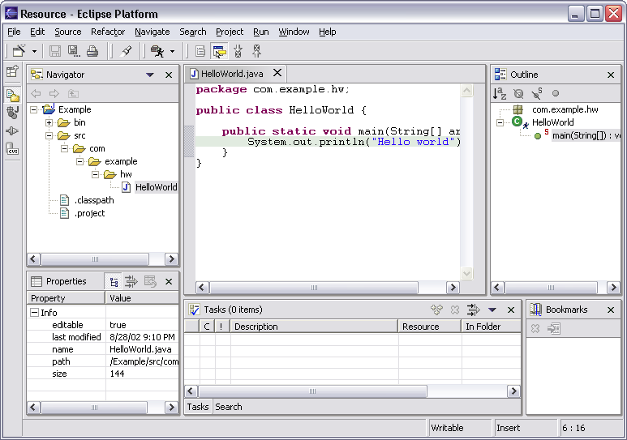
Workbench Terminology
Menu bar
Text
editor
Perspective
and
Fast View
bar
Resource
Navigator
view
Bookmarks
view
Properties
view
Message
area
Editor
Status
area
Stacked
views
Tasks
view
Notes:
[Contains animated elements]

Slide 7
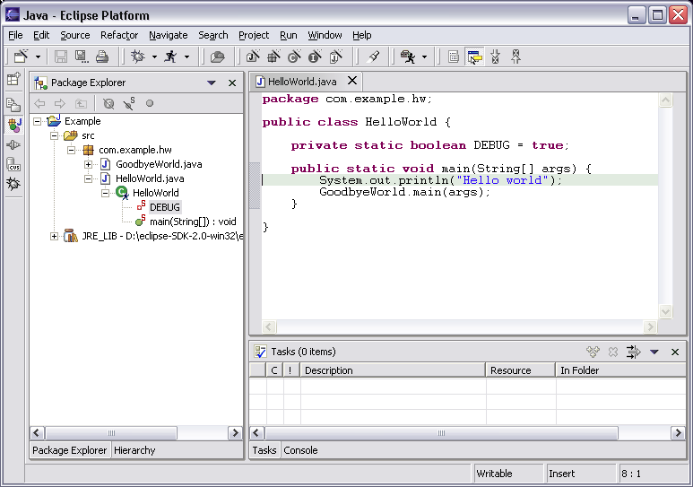
Java Perspective
Java-centric view of files in Java projects
Java elements meaningful for Java programmers
Java project
package
class
field
method
Java editor

Slide 8
Java Editor
Hovering over identifier shows Javadoc spec
Notes:
[Contains animated elements]

Slide 9
Java Editor
Method completion in Java editor
List of plausible methods
Doc for method
Notes:
[Contains animated elements]

Slide 10
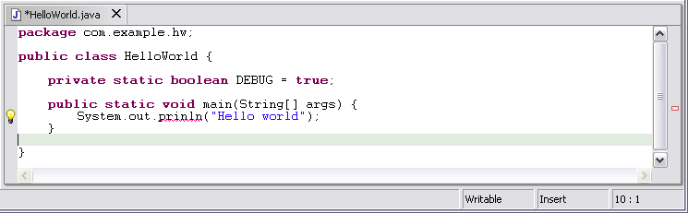
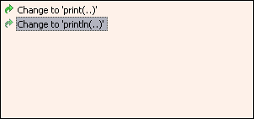
Java Editor
On-the-fly spell check catches errors early
Click
to see
fixes
Problem
Preview
Quick fixes
Notes:
[Contains animated elements]
Syntax and spell checking are done on-the-fly.
Calls Java compiler to parse source code and resolve names in context.
Developers refer to those wavy red lines as “the red sea” :-).
Problem markers are appear in the left margin of editor.
“Red X” instead of “light bulb” if no proposed corrections.

Slide 11
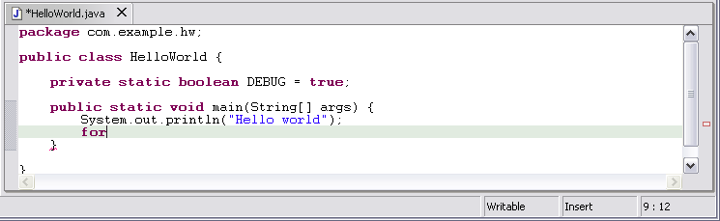
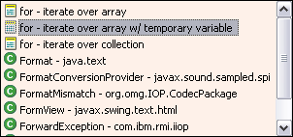
Java Editor
Code templates help with drudgery
Statement template
Preview
Notes:
[Contains animated elements]

Slide 12
And so on…
And so on…
And so on…
More features:
here: www.eclipse.org/eclipse/presentation/eclipse-slides.ppt

Slide 13
Why we really need this?
Simplification of writing code. All attention - to the idea
Helps to write good readable Java code (Formatting, Refactoring)
Simplification of running, debugging process
Because COMP250 instructors advise to use this IDE ☺

Slide 14
Let’s Do Practice
Create your own project:
File → New → Project →→Java Project
Download both files from http://cs.mcgill.ca/~blanchem/250/tutorial/
Put files in your workspace/Project_Name/src
They will automatically appeared in default package under src folder (Project Explorer).
Have a look at Example00.java
Looks good? Let’s run (“Play” button). What’s wrong?!
Have a look at Example01.java
Doesn’t look good? Point on the red underlining. What’s wrong?!

Slide 15
Questions?

Slide 16
Do something useful [Optional]
Use Eclipse as “cool” as possible.
Create any Class.
Create main method. (type “main” and use Ctrl+space). That’s it.
Want output something on the screen (Type “syso” and Ctrl+space).
And bla bla bla… So – you can type “if”, “while”, “for”, “switch”
But remember – computer is still stupid ☺

